Slide 1
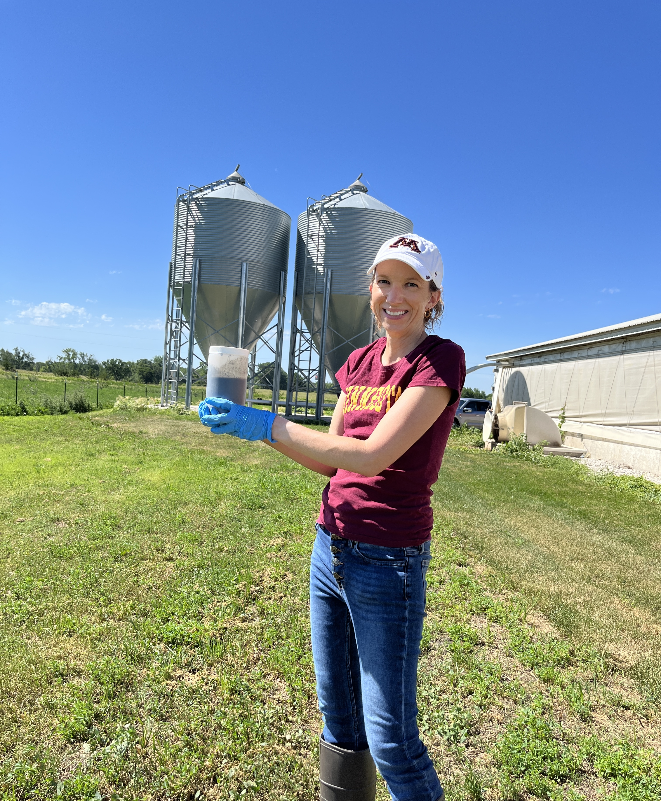
ManureDB: Building a Nationwide Manure Test Database
Nancy Bohl Bormann
PhD Candidate - University of Minnesota
bohlb001@umn.edu @nlbb
MASTPAWG 2023
2/22/2023

Slide 2
Overview
Manure provides nutrients for cropping systems.
Current published livestock manure “book values” (the approximate manure nutrient concentrations) used in the United States (U.S.) are several decades old.
Recent data from several Midwest U.S. labs indicated manure nutrient data has changed compared to published Midwest Plan Service (MWPS) manure book values (2004).
The University of Minnesota has grant funding to create a manure nutrient database called ManureDB to update these values.
We are partnering with laboratories that analyze manure.

Slide 3
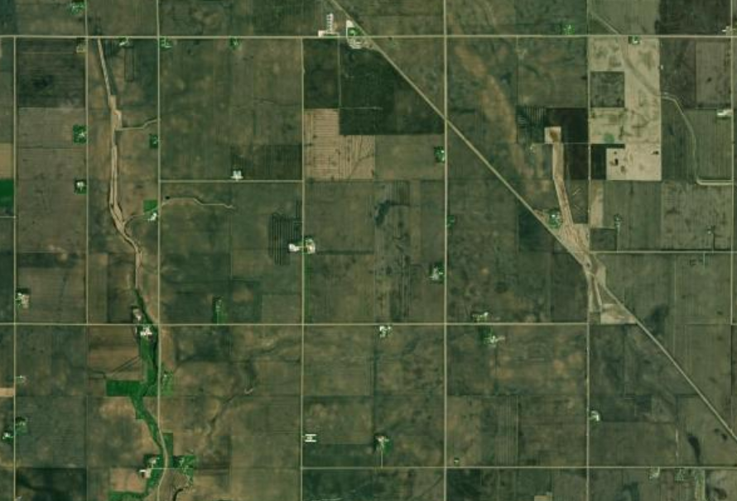
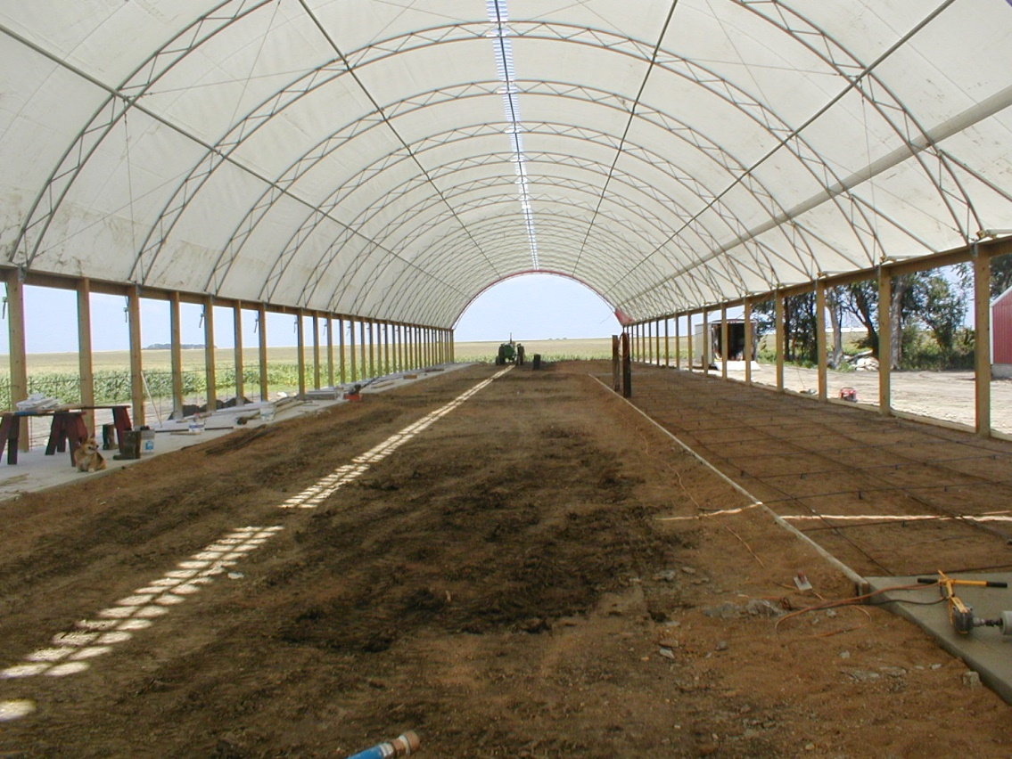
What are manure book values used for?
Developing manure management plans
Designing manure storages
Establishing best management practices for manure land application
Modeling nutrient cycling and gas emissions
Notes:
Organic fertilizer containing essential plant nutrients
Non-homogeneous product
Like commercial fertilizers, need to be aware of the environmental risk of losing nitrogen (N) and/or phosphorus (P)

Slide 4
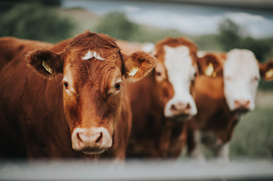
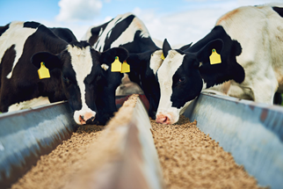
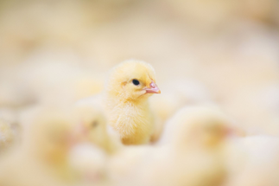
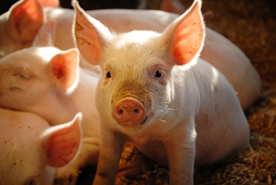
Preliminary Lab Data
Three Midwestern laboratories
Over 80,000 samples!
Samples from 2012-2021
Sorted between liquid and solid
Divided into four main
livestock groups
Beef
Dairy
Poultry
Swine
Notes:
Lab results and book values had various units converted into:
lbs of nutrient/ton for solid manure
lbs of nutrient/1000 gallons for liquid manure
Calculated medians of total nitrogen, NH₄-N, P₂O₅, and K₂O analyses
No differentiations for most of these samples of:
Housing
Manure storage
Age

Slide 5
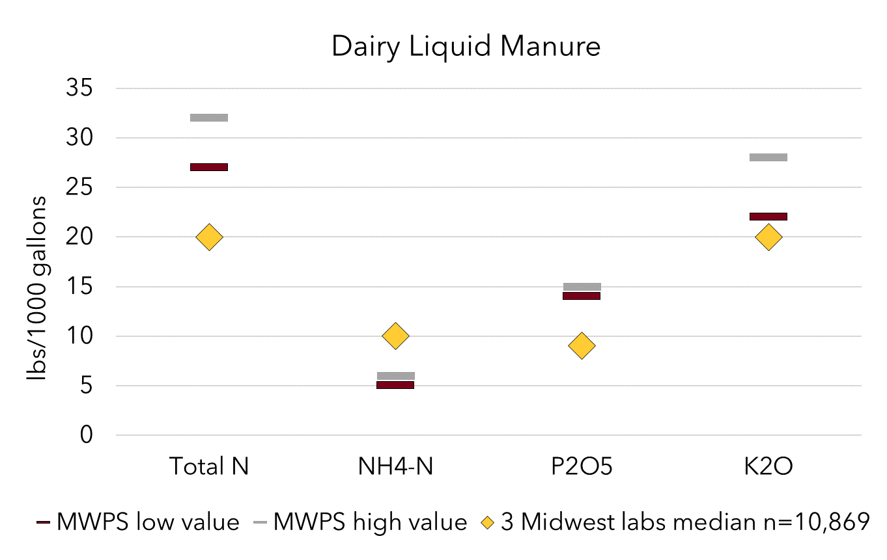
Comparing MWPS to 3 Labs - Dairy Liquid Manure
Total N
NH₄-N
P₂O₅
K₂O
Notes:
Dairy TN – lower
NH4-N -higher
P lower
K lower

Slide 6
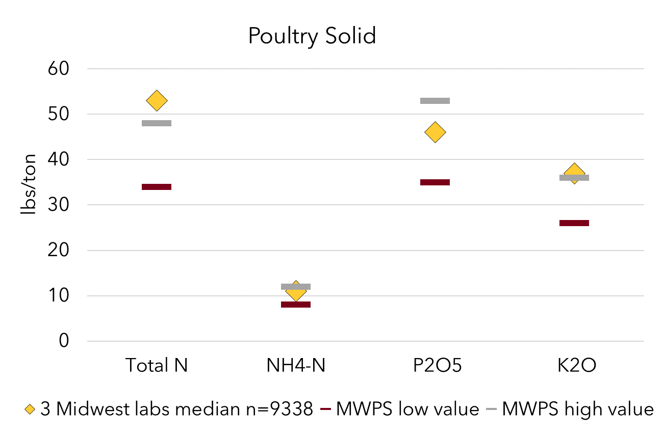
Comparing MWPS to 3 Labs - Poultry Solid Manure
Total N
NH₄-N
P₂O₅
K₂O

Slide 7
Takeaway from this preliminary study
Preliminary data from 3 labs showed changes in manure trends from published manure book values
Detailed metadata will be key for future robust comparisons
Notes:
Proving what many had long suspected….

Slide 8
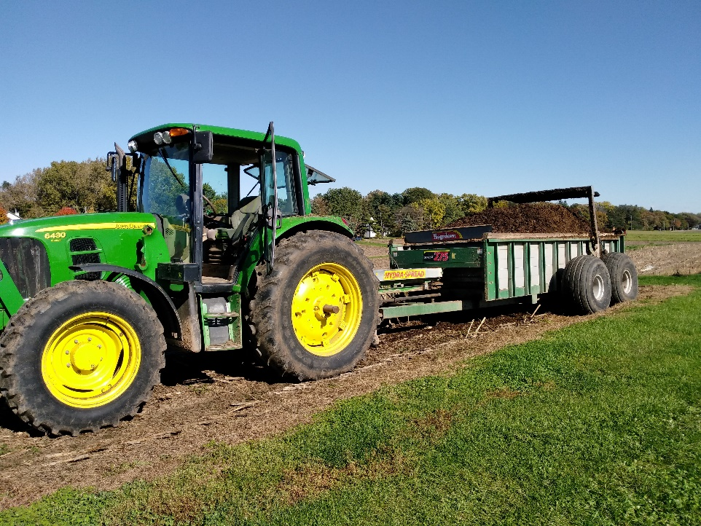
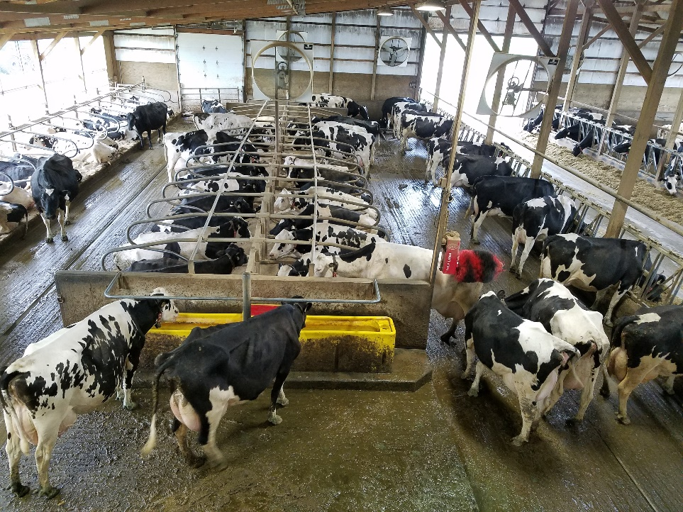
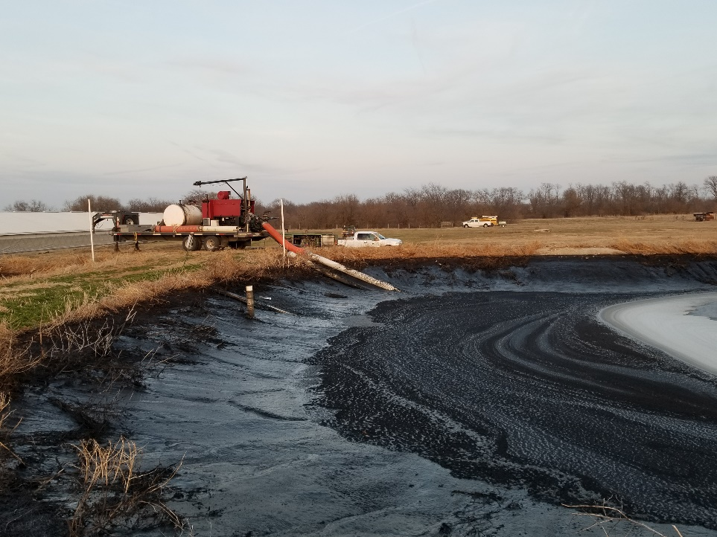
Most samples had minimal descriptions beyond animal species and little is known about storage types
Age
Nutrition
Housing
Manure Handling and Treatment
Storage

Slide 9
ManureDB: Nationwide Manure Test Database
-Minnesota Supercomputing Institute
-Stakeholder group
-Schema
-Database
-Website
-Laboratory cooperation
-Currently cleaning and uploading data
-Over 58,000 samples in the database with more getting processed for entry
Notes:
Bigger than a spreadsheet

Slide 10
Project Team
Commercial manure laboratories
Livestock commodity groups
Alternative energy groups
Regulatory & agency staff
Ag professionals
Researchers
Engineers

Slide 11
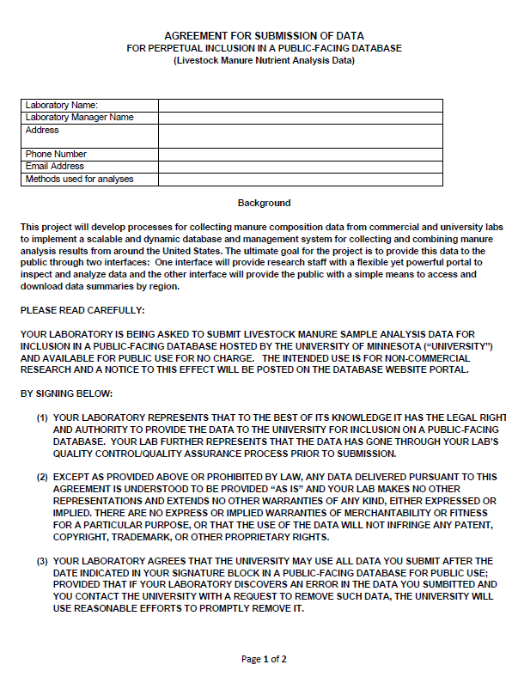
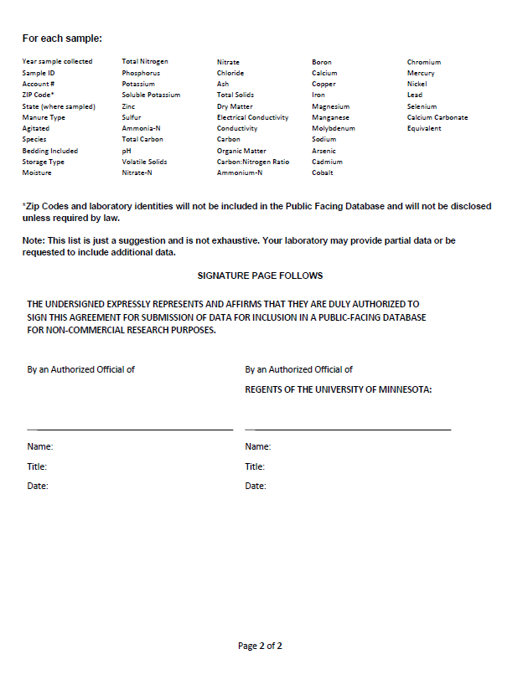
Data Use Agreement & Privacy Concerns
Two-page agreement between the University of Minnesota and participating laboratory
No customer names or addresses
Only first 3 digits of the ZIP code will be imported into the database
ZIP codes and laboratory identities will not be included in the Public Facing Database
At least four samples will be needed to publicly show up in summaries

Slide 12
Schema

Slide 13
Survey Data Template
Lab Name
Year Analyzed (required)
Date Sampled, Date Received, Date Analyzed, Date Reported
Sample ID, Account #
ZIP Code, State
Sample Notes
Manure Type
Animal or Other Amendment Type
Manure Treatment
Agitated
Bedding Included
Storage Type
Length of Storage
Application Method
Targeted Analytes

Slide 14
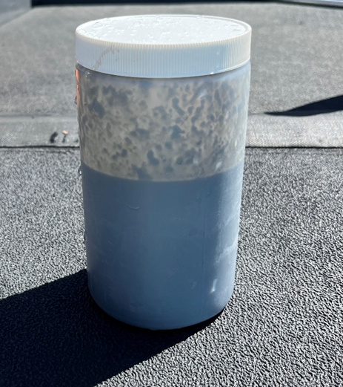
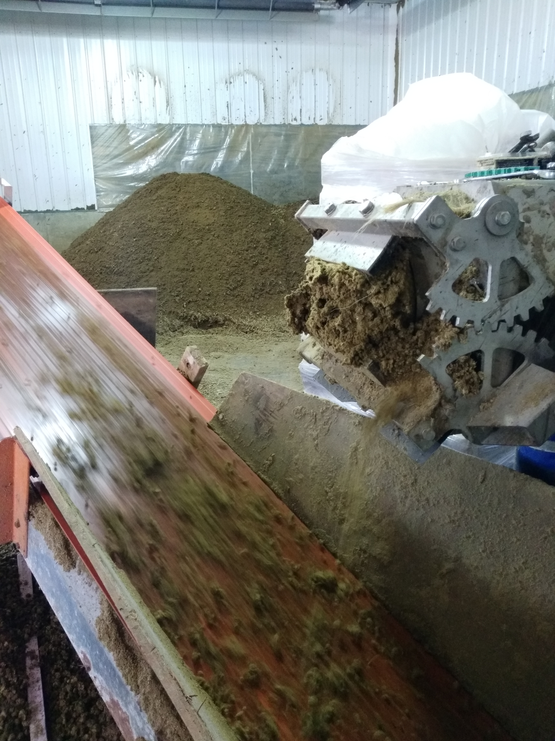
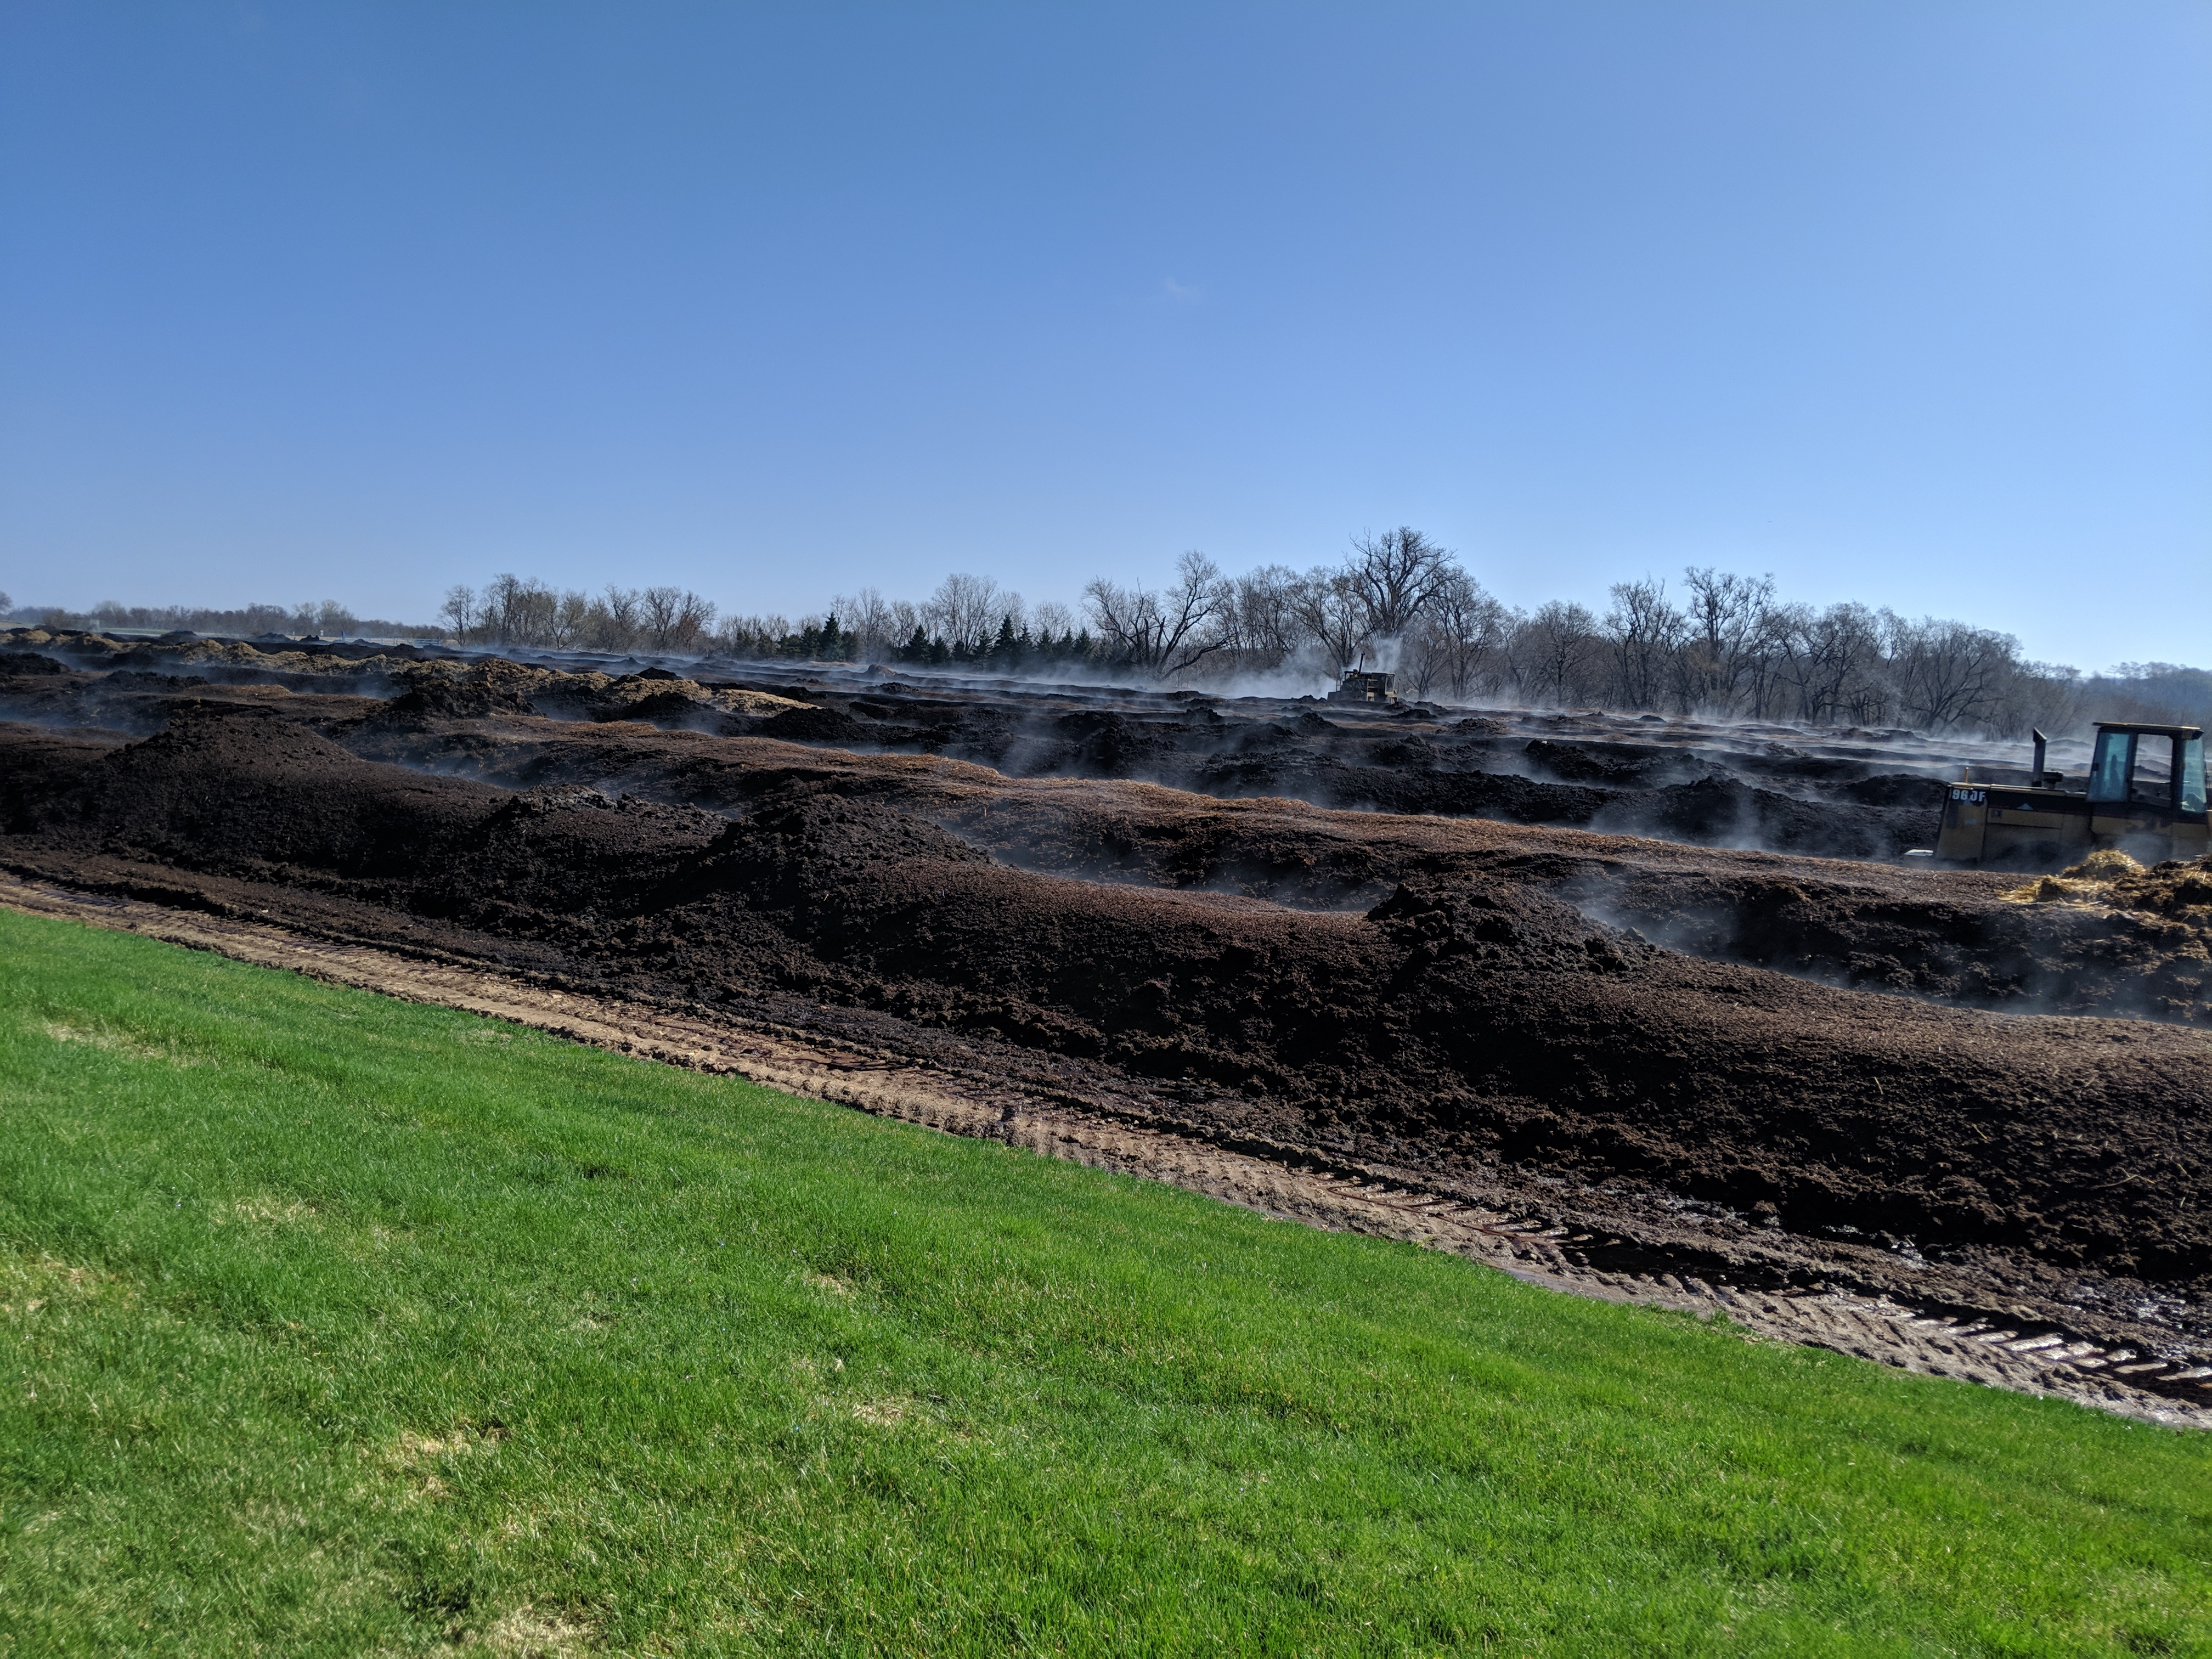
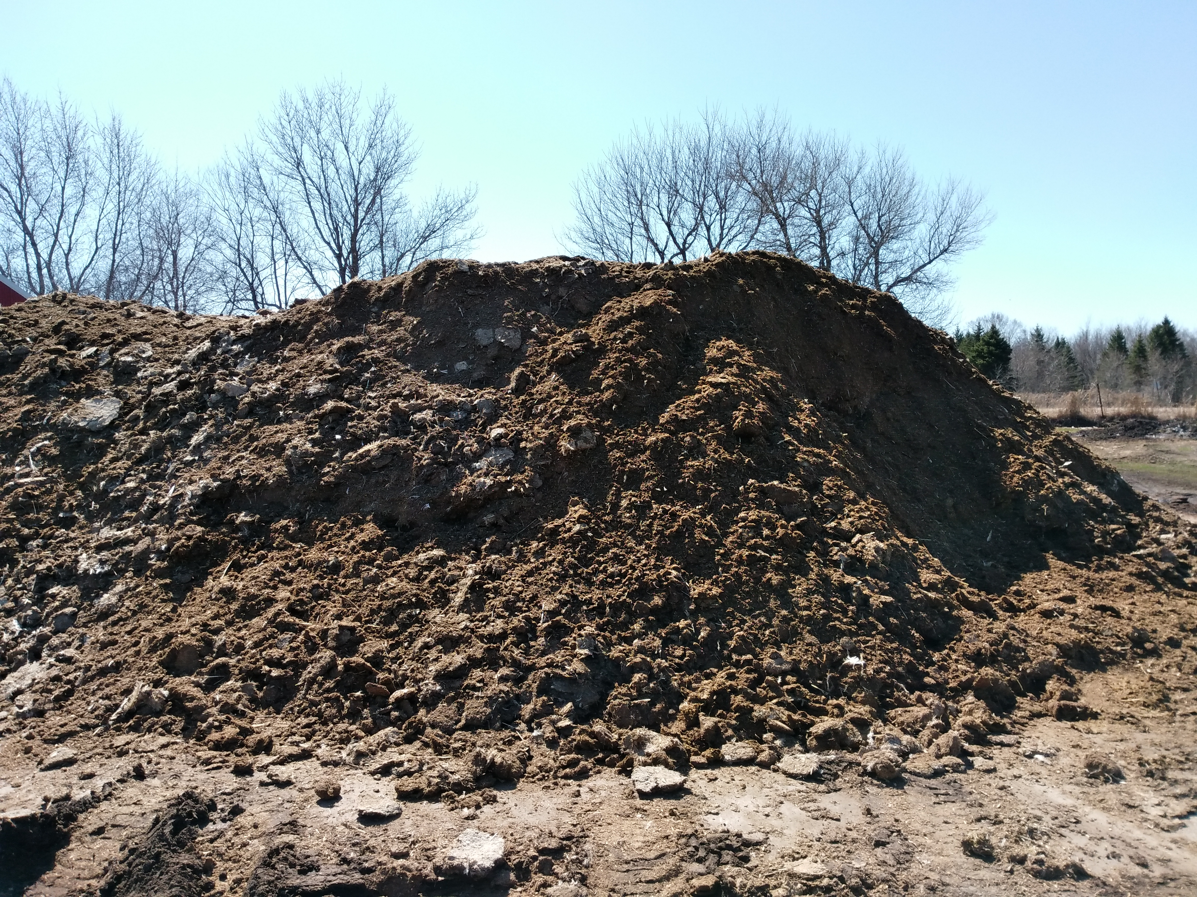
Manure Type
Liquid
Slurry
Semi-solid
Solid
Separated Solid
Digestate
Runoff
Sludge
As-excreted (urine)
As-excreted (feces)
Litter
Compost
Unknown

Slide 15
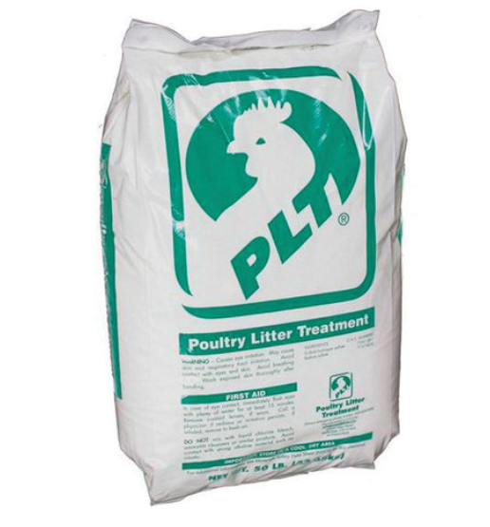
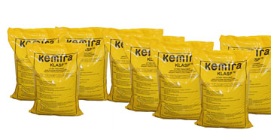
Manure Treatment
No Treatment
Alum
KLASP
Phytase
PLT
Poultry Guard
Other Treatment
Unknown

Slide 16
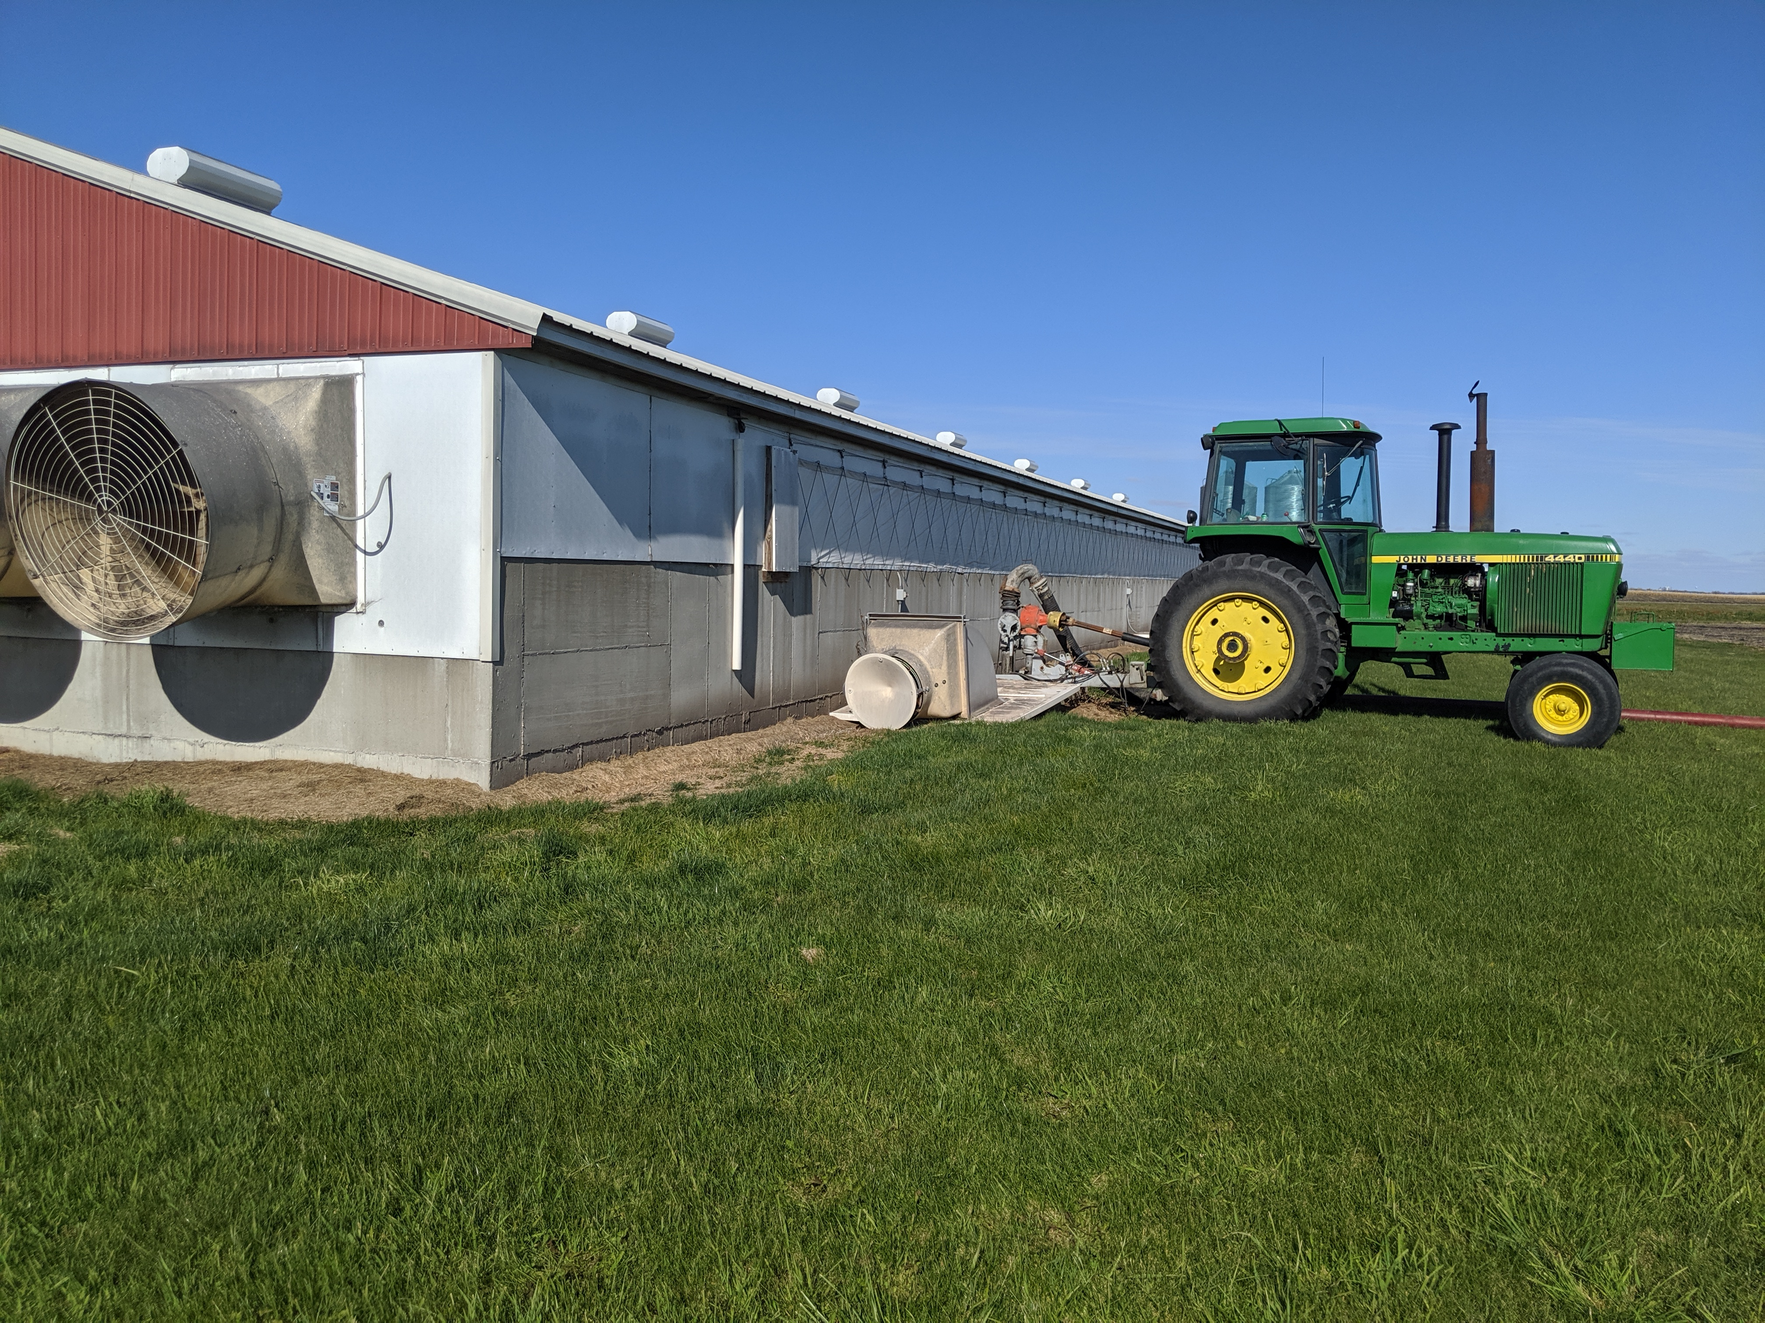
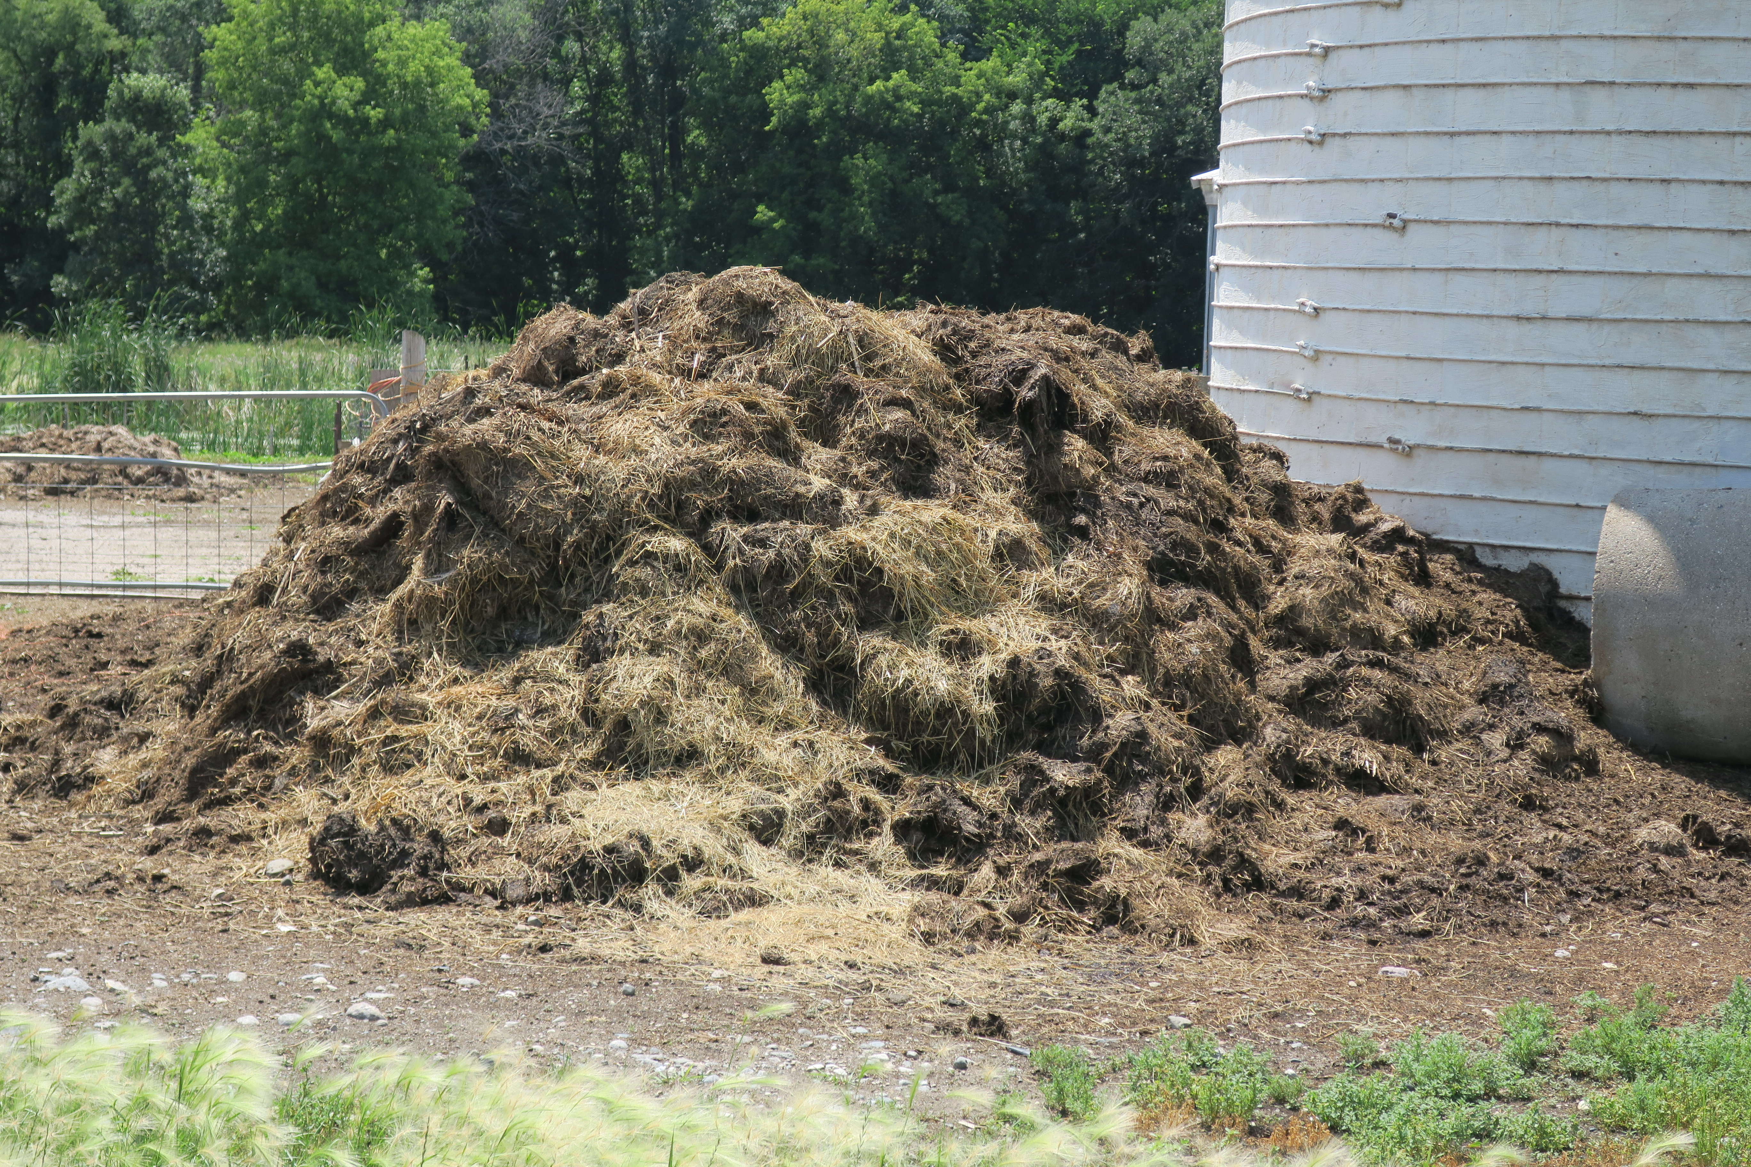
Agitated?
Bedding Type
Length of Storage?
Yes
No
Unknown
Hardwood Sawdust
Hardwood Shavings
Peanut Hulls
Pine Sawdust
Pine Shavings
Rice Hulls
Sand
Straw
Not Included
Other/Unspecified Bedding
Unknown
Daily haul
0 to <3 months
3 to <6 months
6 to <12 months
12+ months

Slide 17
Animal or Other Amendment Type
Goat
Guinea Pig
Horse
Llama
Mink
Mouse
Partridge
Pigeon
Poultry
Rabbit
Rat
Quail
Sheep
Alpaca
Bat
Beef - Breeding
Beef - Calf
Beef - Replacement Heifers
Beef - Stocker
Beef
Biosolids
Bison
Cattle
Chicken
Chicken - Breeder
Chicken - Broiler
Chicken - Layer
Chicken - Pullet
Dairy - Calf
Dairy - Calf and Heifer
Dairy - Heifers
Dairy - Lactating Cow
Dairy - Dry Cow
Dairy
Deer
Donkey
Duck
Elephant
Elk
Emu
Ferret
Fish
Geese
Swine - Farrow to Wean
Swine - Farrow to Feeder
Swine - Farrow to Finish
Swine - Feeder to Finish
Swine - Finisher
Swine – Gestation
Swine - Wean to Finish
Swine - Nursery
Swine - Boar Stud
Swine
Turkey
Turkey - Meat
Turkey - Hen
Veal
Worm
Other - Egg Wash Water
Other - Fish Pond Sludge
Other – Grape Pomace
Other - Mushroom
Other - Paunch
Other - Sewage Sludge
Other - Truck Wash
Mixed
Unknown

Slide 18
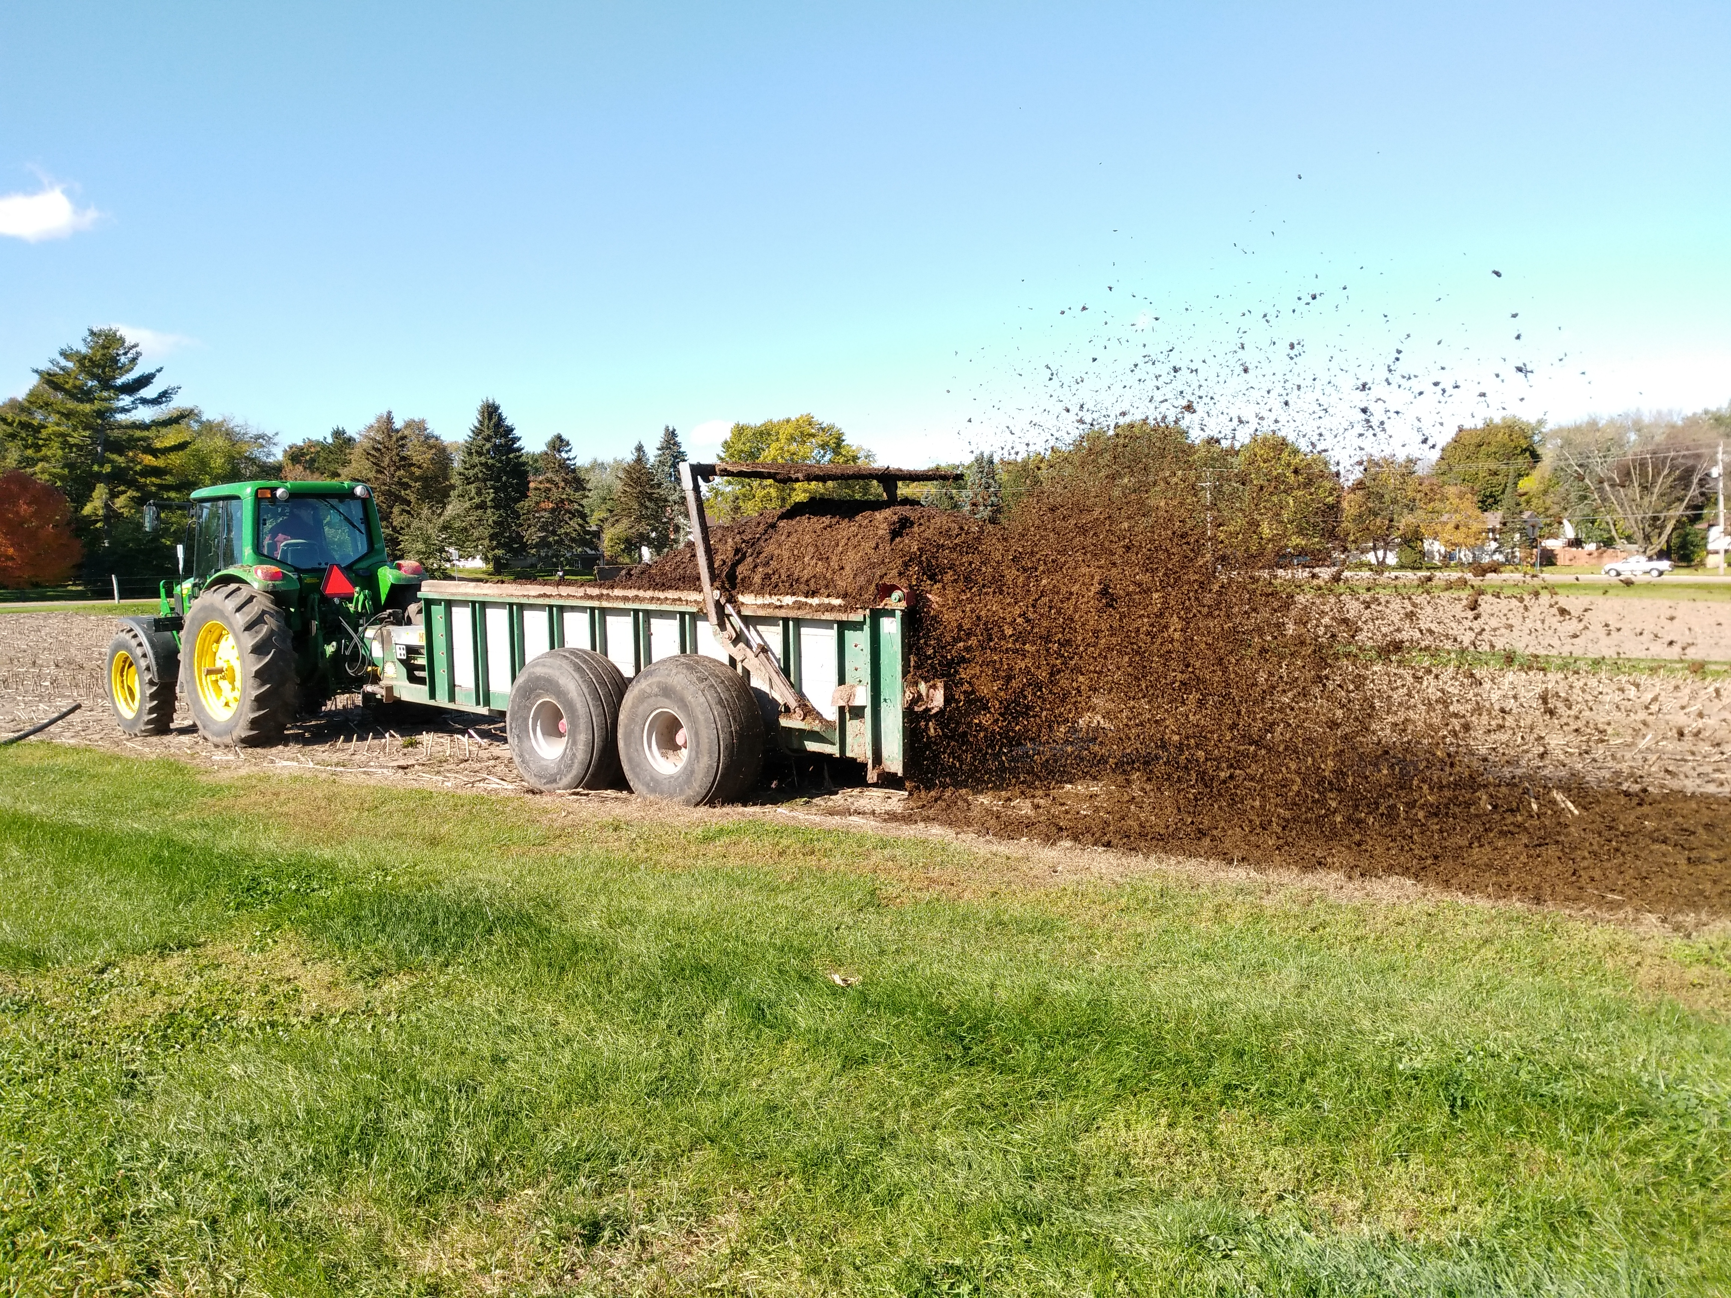
Storage Type
Application Method
Lagoon
Uncovered Pit or Tank
Covered Pit or Tank
Earthen Basin
Runoff Holding Pond
Solid
Underfloor Solid Storage
Stockpiled Under Cover
Stockpiled Outdoors
Cage-free Poultry
Unknown
Irrigation
Broadcast
Broadcast - Incorporated within 24 hours
Broadcast - Incorporated after 24 hours
Injection
Unknown

Slide 19
Targeted Analytes
Moisture
Total Nitrogen
Phosphorus
Water Extractable Phosphorus
Potassium
Soluble Potassium
Zinc
Sulfur
Total Carbon
Total Organic Carbon
pH
Volatile Solids
Total Suspended Solids
Nitrate-N
Chloride
Ash
Total Solids
Electrical Conductivity
Organic Matter
Carbon:Nitrogen Ratio
Ammonium-N
Boron
Calcium
Copper
Iron
Magnesium
Manganese
Molybdenum
Sodium
Arsenic
Cadmium
Cobalt
Chromium
Mercury
Nickel
Lead
Selenium
Aluminum
Barium
Silicon
Strontium
Calcium Carbonate Equivalent (CCE)
Sodium Absorption Ratio (SAR)
Cation Ratio of Soil Structural Stability (CROSS)
Fecal Starch
Notes:
Recommended methods of manure Analysis

Slide 20
Choose Method, Basis, Units
Methods options based on:
Recommended Methods of Manure Analysis
AgGateway Modus Agronomic Testing Lab Standard (currently updating!)
Interviews with labs
Basis
As received (wet)
Dry
Units
%
ppm
lbs/1000 gal
lbs/ton

Slide 21
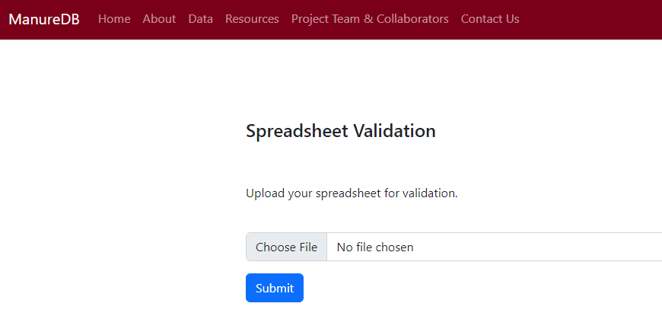
Spreadsheet Validation
Checks that all the parameters are consistent
Columns need to be cleaned up or edited
Once it passes, we can upload to the database

Slide 22
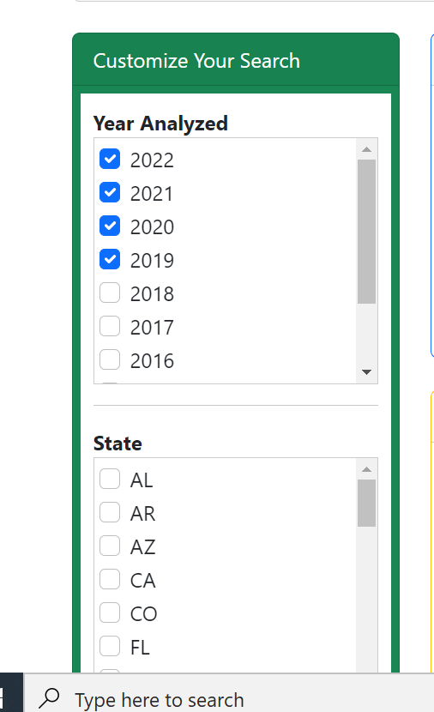
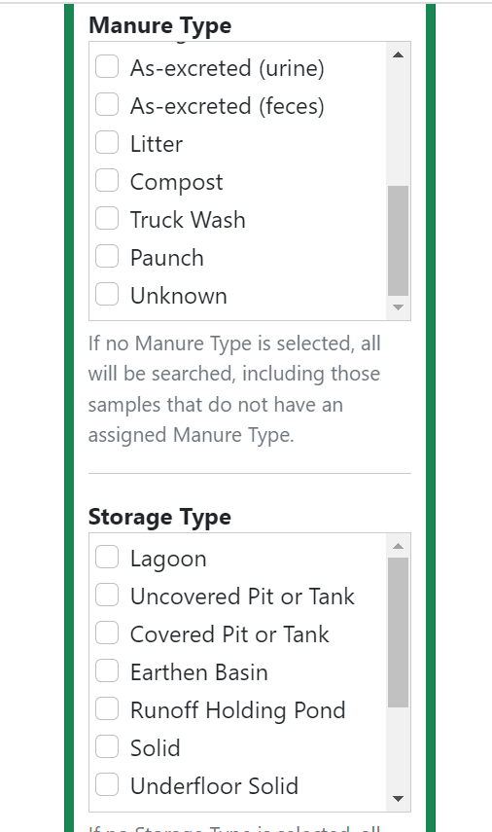
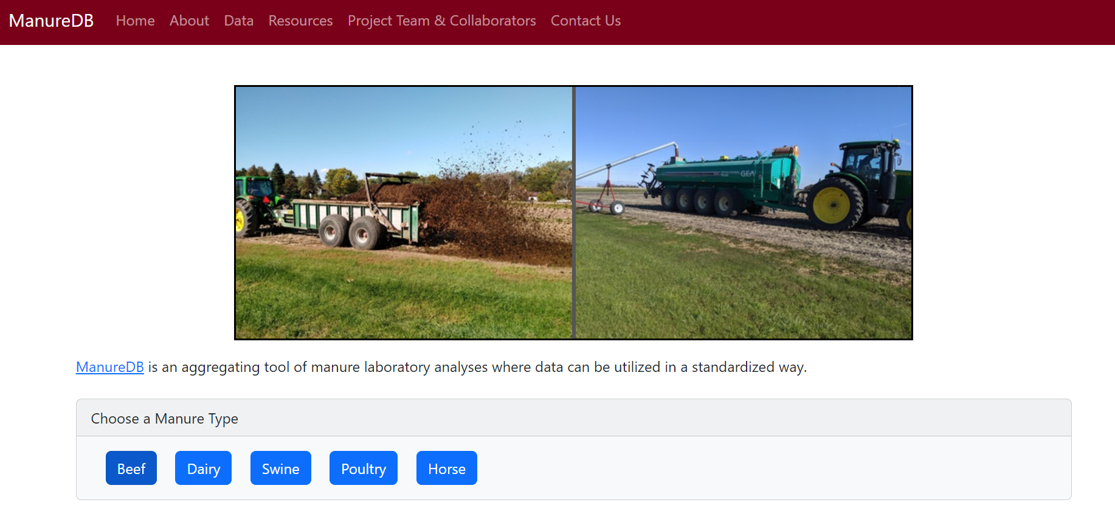
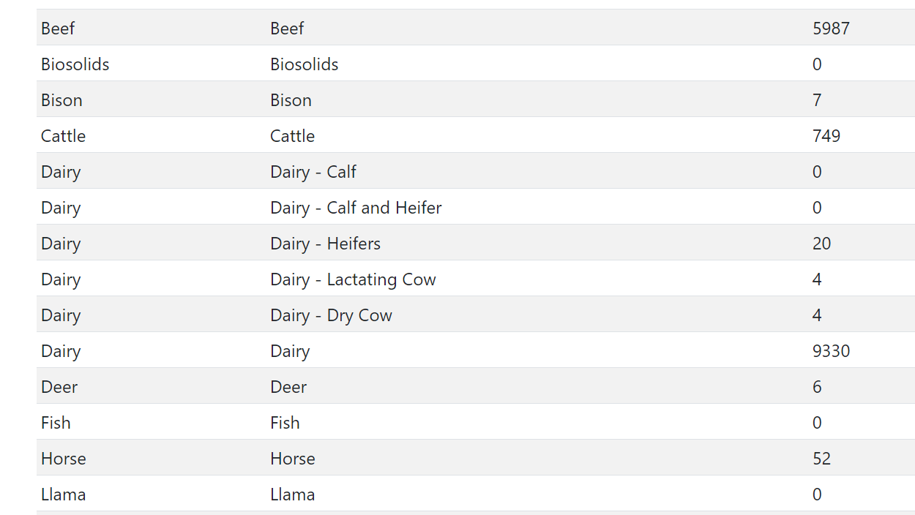

Slide 23
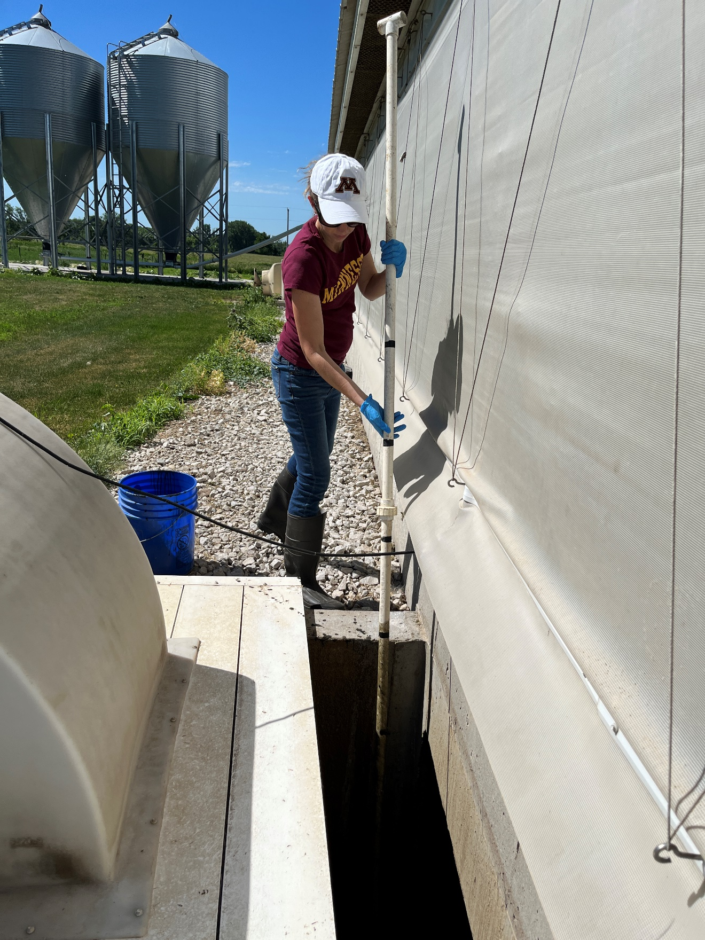
Future Plans
Finish construction and user-testing of ManureDB beta site in collaboration with participating laboratories
Publish ManureDB as a publicly available website
Continue to recruit more laboratories to participate in the database
Notes:
ManureDB website:
http://manuredb.umn.edu
Ag Data Commons

Slide 24
What are the steps to get data in ManureDB?
Contact me or manure@umn.edu
We can set up an initial meeting to learn more about the manure database project and your laboratory
Send out the data use agreement for signatures
Once signed by the lab, U of M will sign and return the fully executed agreement
We can meet again to review the lab’s methods, analytes, column names if needed
Send a spreadsheet of your lab’s data, as far back as you wish to go
We work through the spreadsheet validation process and may have a few questions for the lab as we go
Import into ManureDB!

Slide 25
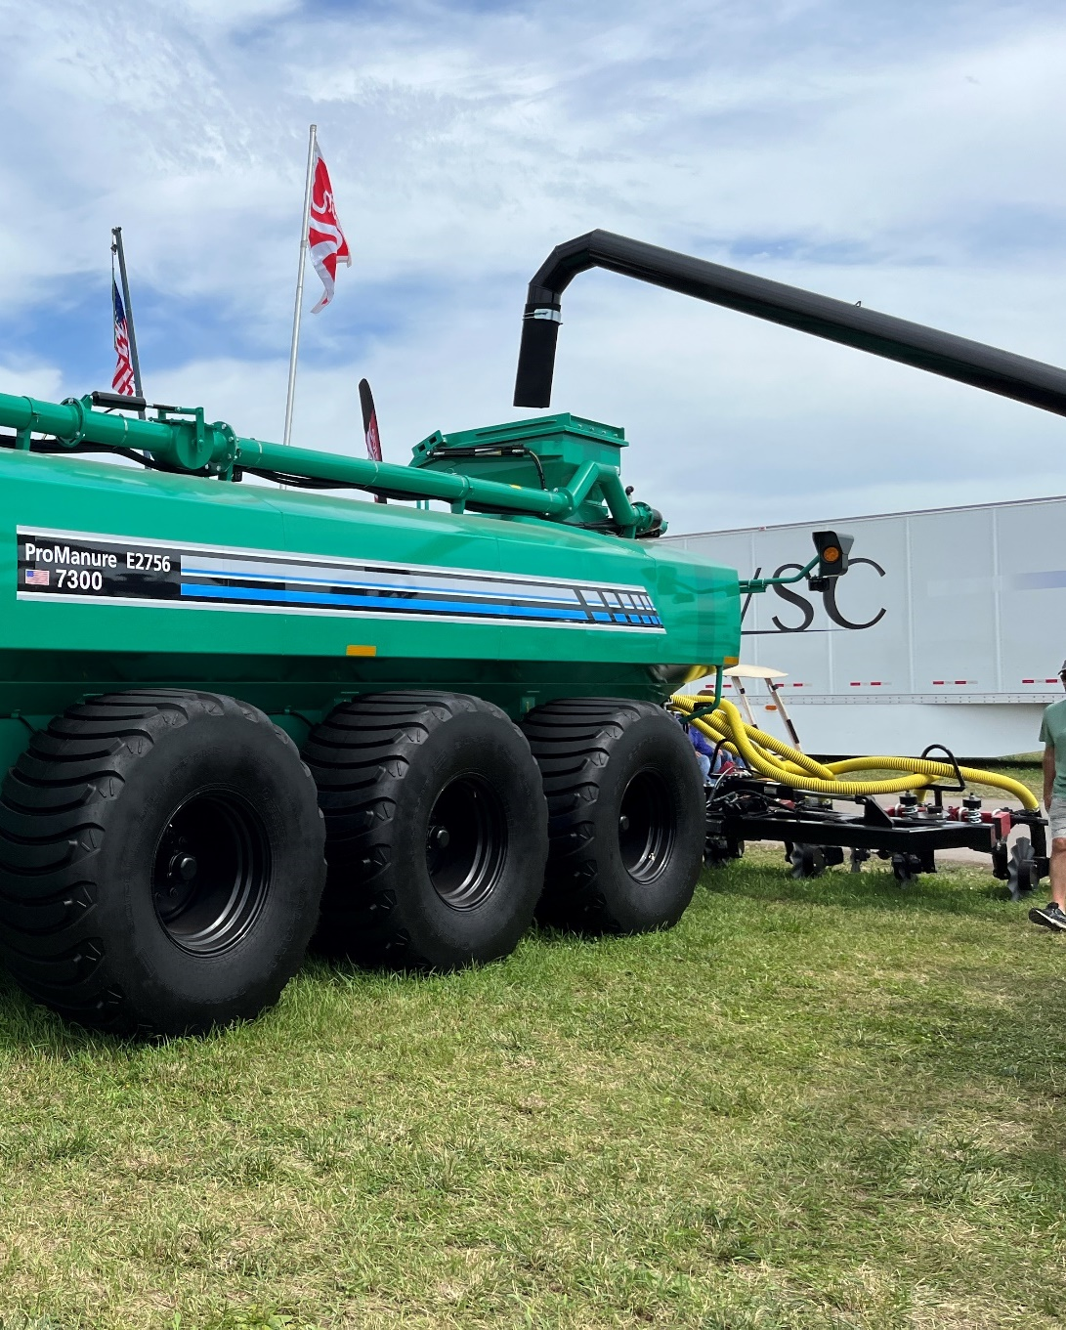
Stay in the loop!
Interested in learning more?
manure@umn.edu
z.umn.edu/
ManureDB-signup
ManureDB is supported through USDA NIFA Award 2020-67021-32465.

Slide 26
Acknowledgements
Additional Authors:
Melissa L. Wilson, Associate Professor, University of Minnesota
Erin L. Cortus, Associate Professor and Extension Engineer, University of Minnesota
Kevin Janni, Extension Engineer, University of Minnesota
Larry Gunderson, Pesticide & Fertilizer Management, Minnesota Department of Agriculture
Kevin Silverstein, Scientific Lead RIS Informatics Analyst, University of Minnesota
This work is supported by the AFRI Foundational and Applied Science Program [grant no. 2020-67021-32465] from the USDA National Institute of Food and Agriculture, the University of Minnesota College of Food, Agricultural and Natural Resource Sciences, and the Minnesota Supercomputing Institute.

Slide 28
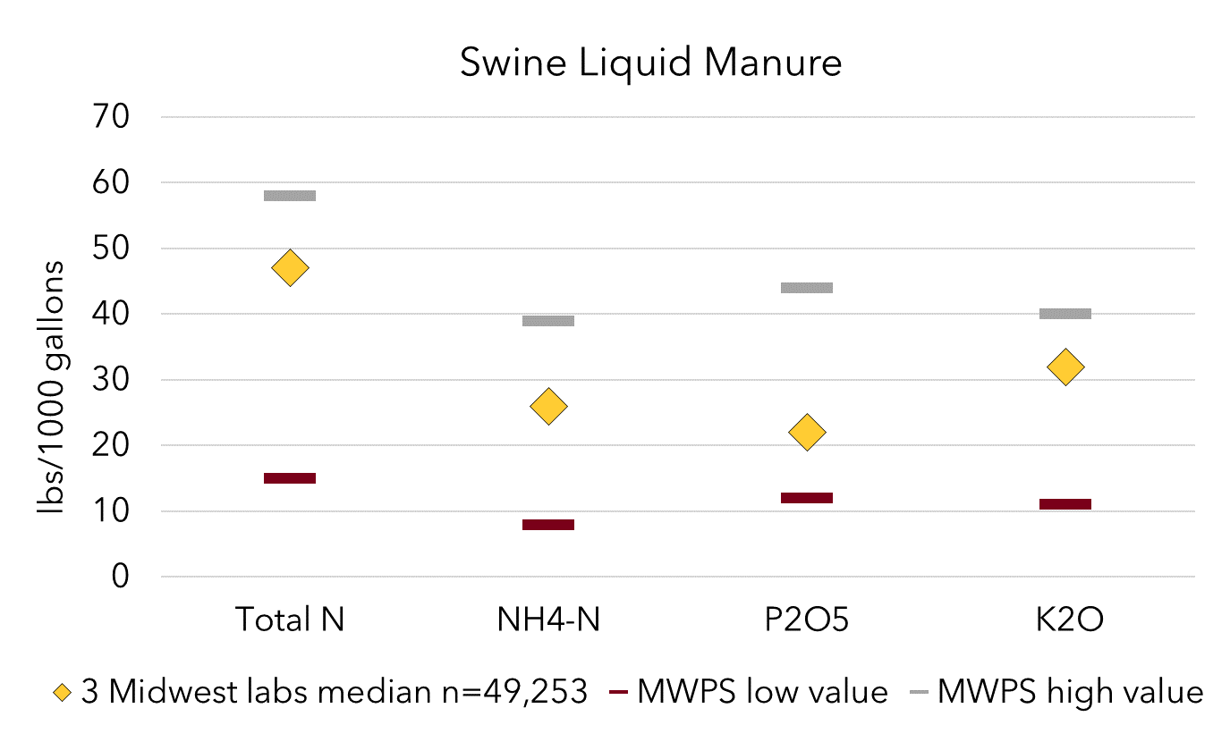
Comparing MWPS to 3 Labs - Swine Liquid Manure
Total N
NH₄-N
P₂O₅
K₂O
Notes:
With differences in swine age and housing, wide variety of values and the 3 lab medians were within the MWPS ranges

Slide 29
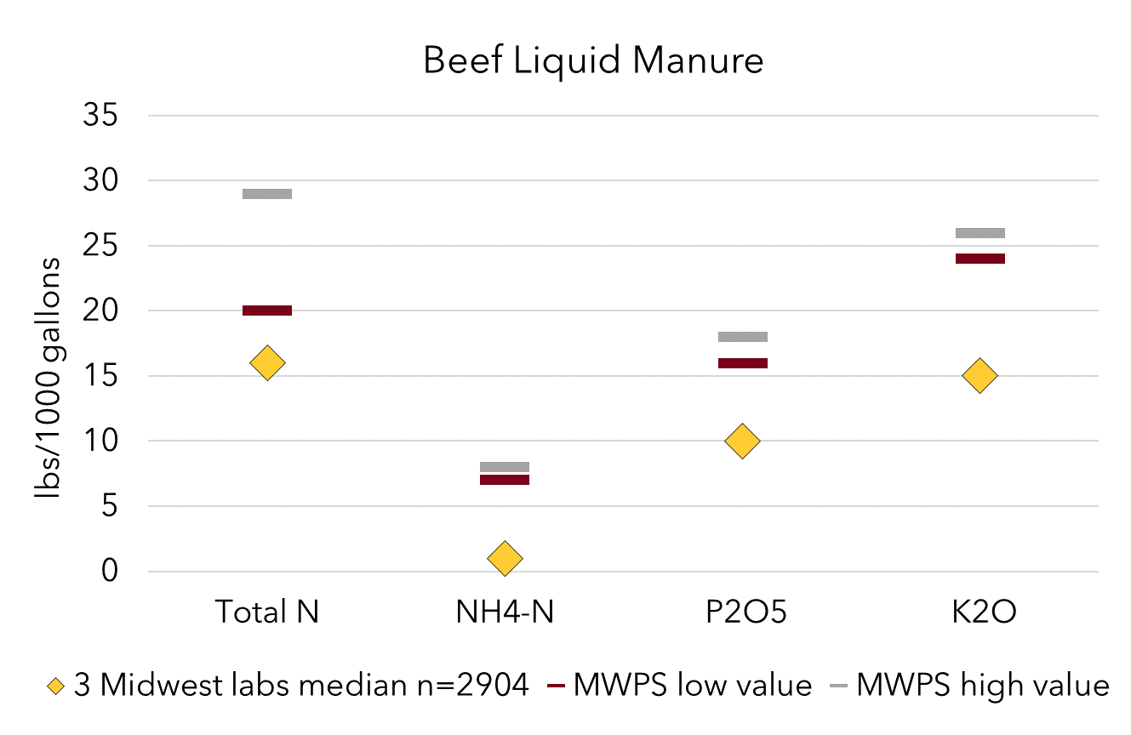
Comparing MWPS to 3 Labs - Beef Liquid Manure
Total N
NH₄-N
P₂O₅
K₂O

Slide 30
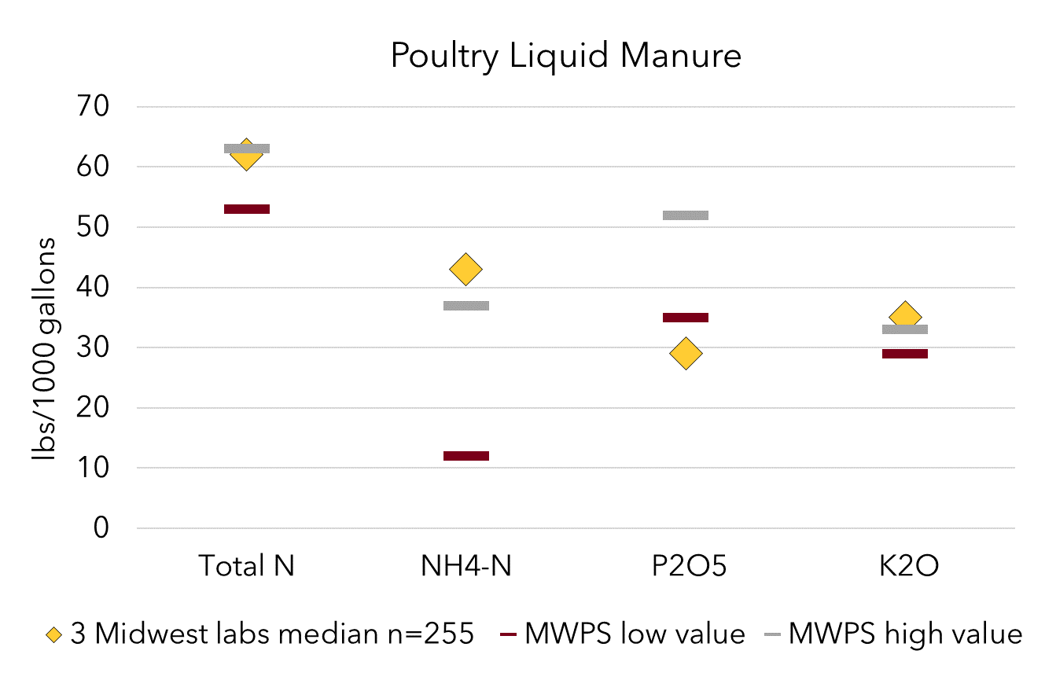
Comparing MWPS to 3 Labs - Poultry Liquid Manure
Total N
NH₄-N
P₂O₅
K₂O
Notes:
N – higher

Slide 31
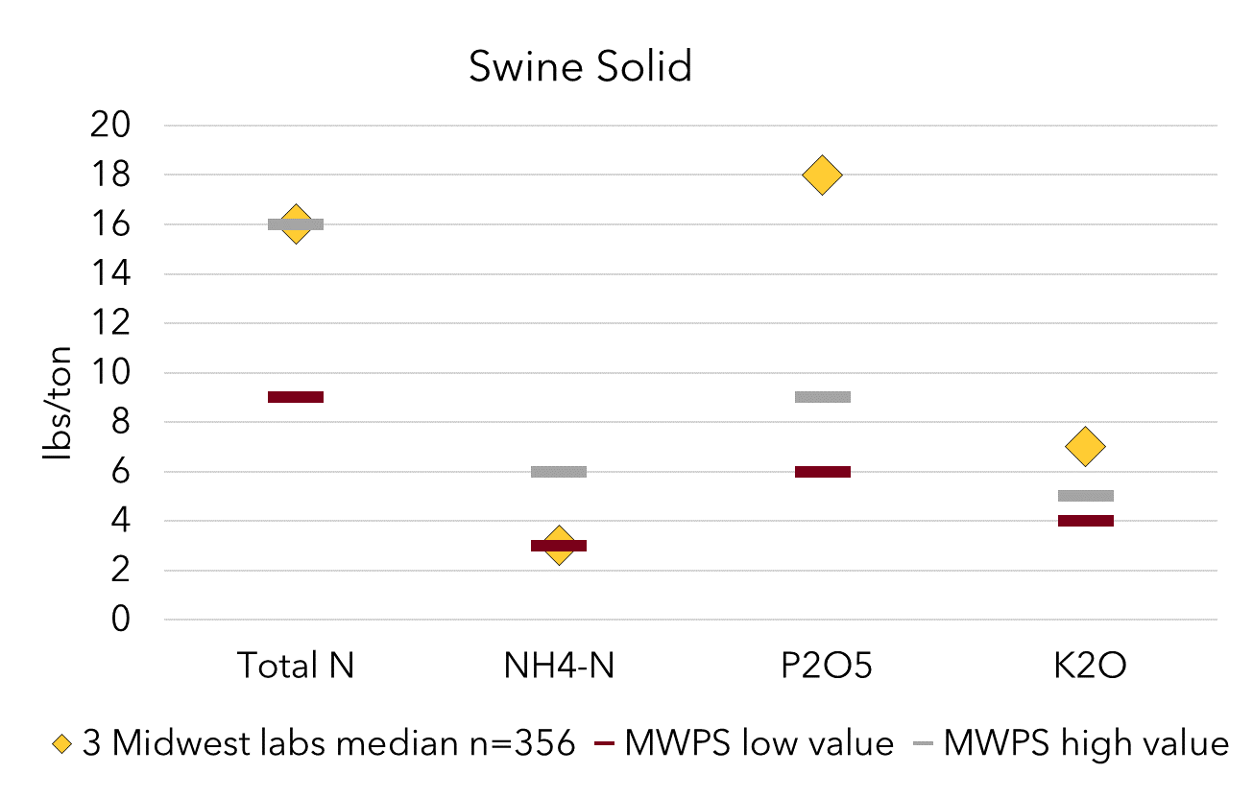
Comparing MWPS to 3 Labs - Swine Solid Manure
Total N
NH₄-N
P₂O₅
K₂O

Slide 32
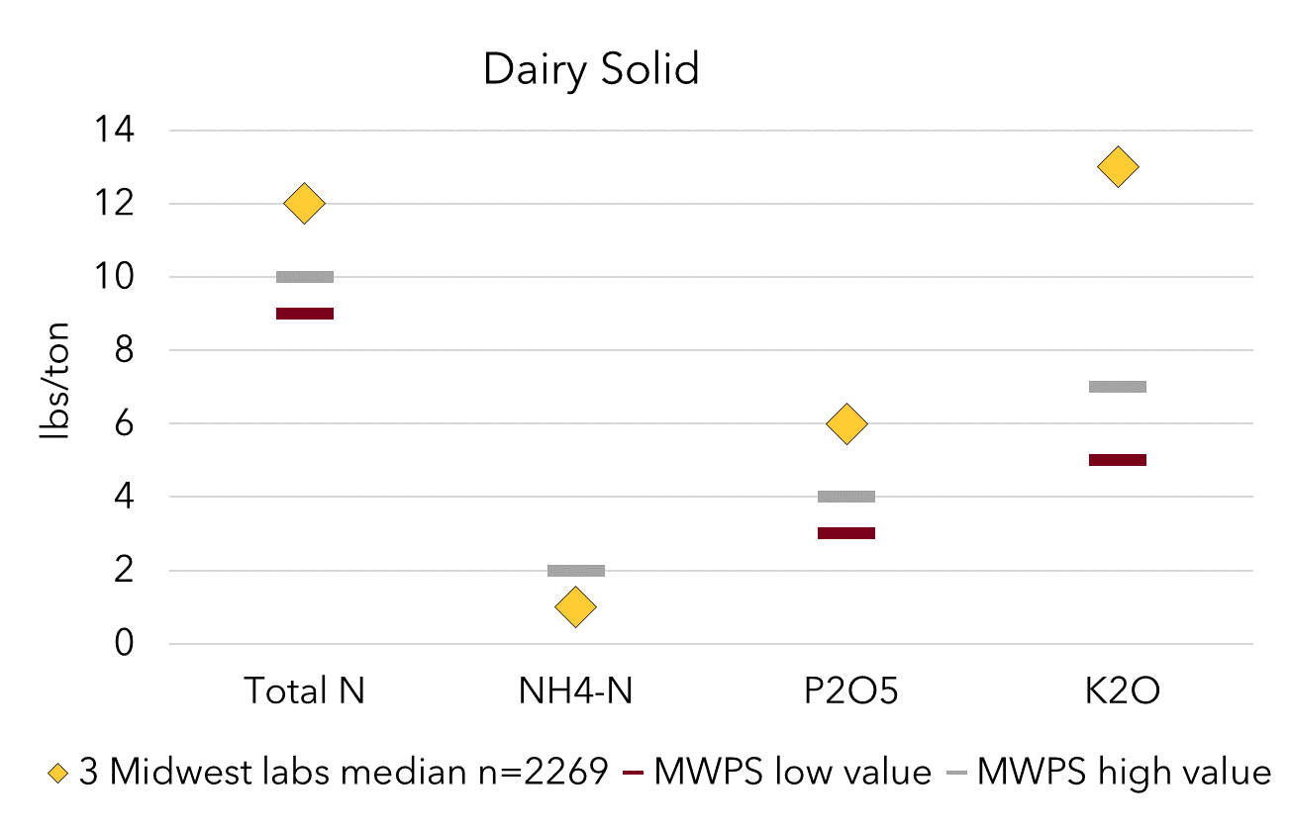
Comparing MWPS to 3 Labs - Dairy Solid Manure
Total N
NH₄-N
P₂O₅
K₂O

Slide 33
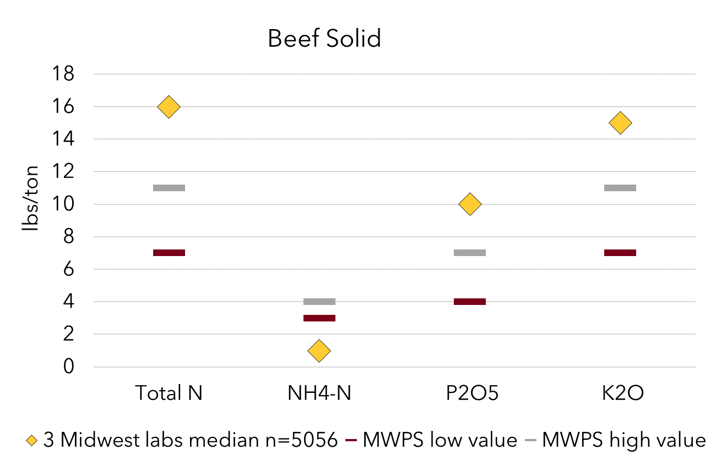
Comparing MWPS to 3 Labs - Beef Solid Manure
Total N
NH₄-N
P₂O₅
K₂O

Slide 34
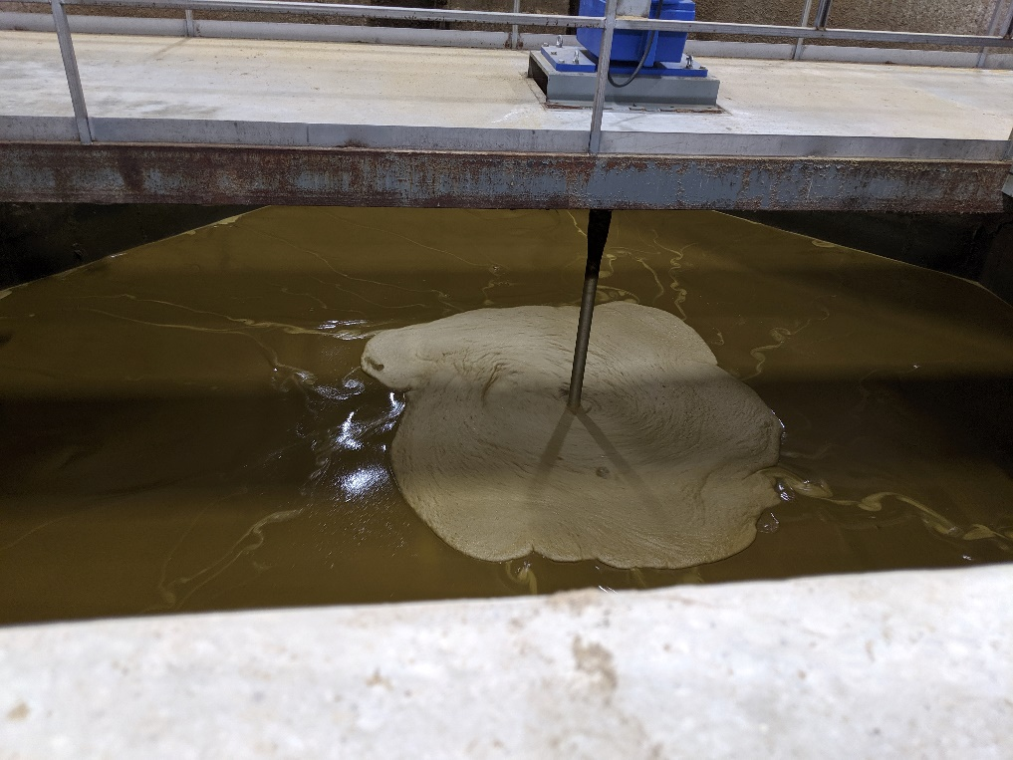
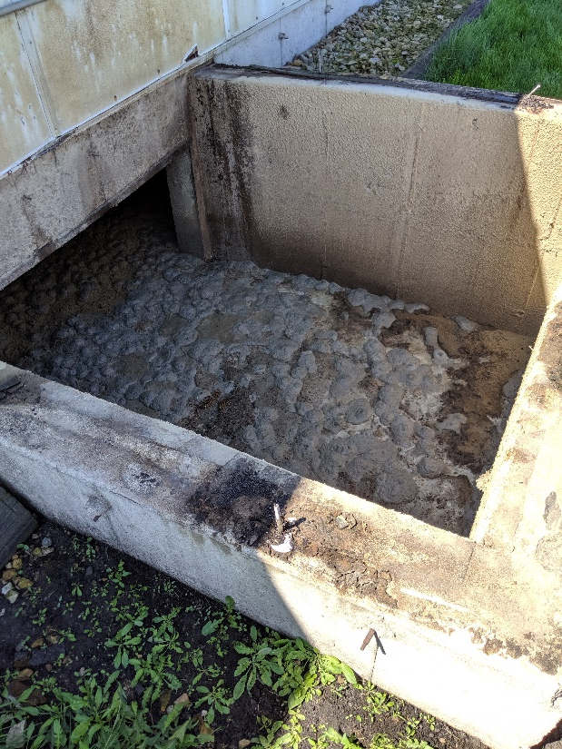
Liquid Manure sample trends 2012-2021 compared to MWPS/ASABE manure book values.
(+) = trending higher
(o) = no change/conflicting samples
(-) = trending lower
Liquid | Total N | NH₄-N | P₂O₅ | K₂O
Swine | o | o | - | +
Dairy | - | o | - | o
Beef | o | o | o | o
Poultry | o | + | - | +
Notes:
Wilson photos

Slide 35
Dairy Liquid N
Livestock Type | Total N
MWPS | lbs/1000 gal of manure
Dairy Cow | 31
Dairy Heifer | 32
Dairy Calf | 27
Dairy Herd | 31
ASABE
Dairy lagoon effluent | 6
Dairy slurry | 25
3 Midwest labs
Dairy | 20
1 East lab
Dairy | 24
Notes:
3 lab 10869 samples
East lab 528 samples

Slide 36
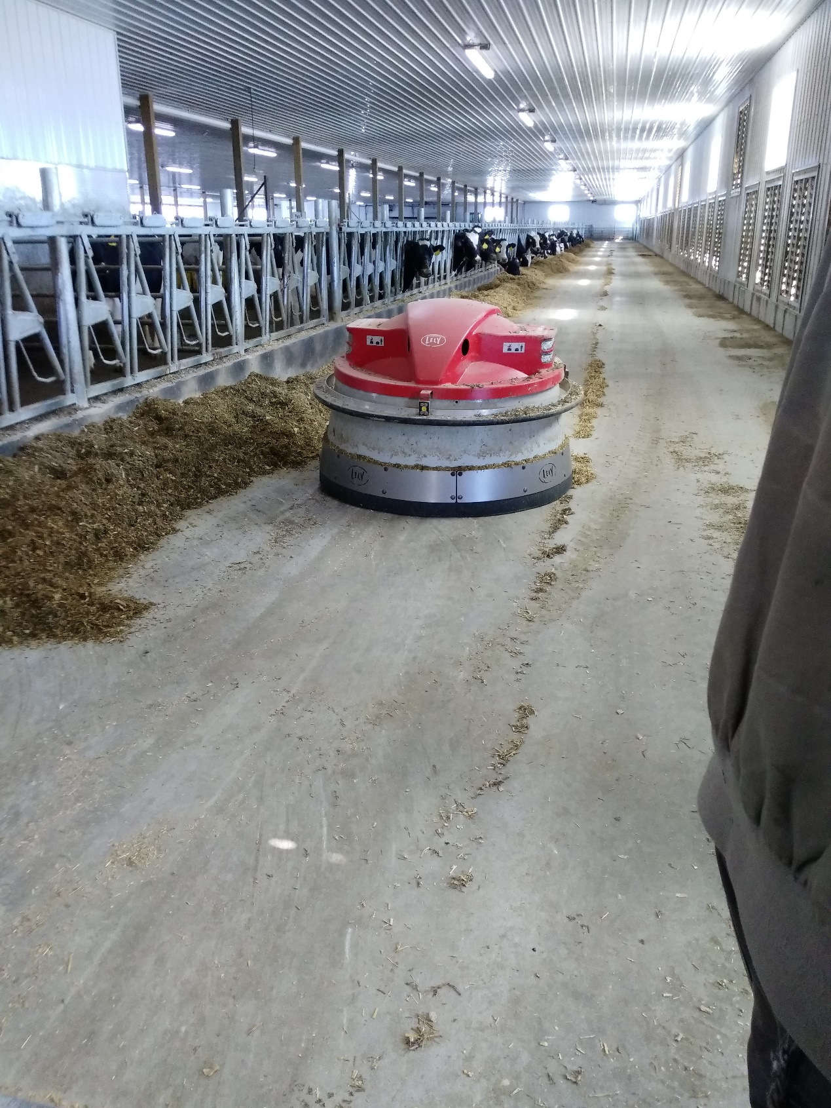
Dairy Liquid P
Livestock Type | P₂O₅
MWPS | lbs/1000 gal of manure
Dairy Cow | 15
Dairy Heifer | 14
Dairy Calf | 14
Dairy Herd | 15
ASABE
Dairy lagoon effluent | 3
Dairy slurry | 25
3 Midwest labs
Dairy | 9
1 East lab
Dairy | 9
Notes:
3 Midwest labs 10,869 samples
1 eastern lab 528 samples

Slide 37
Swine Liquid P
Livestock Type | P₂O₅
MWPS | lbs/1000 gal of manure
Swine Farrowing | 12
Swine Nursery | 19
Swine Grow-Finish (deep pit) | 42
Swine Grow-Finish (wet/dry feeder) | 44
Swine Grow-Finish (earthen pit) | 22
Swine Breeding-Gestation | 25
Swine Farrow-Finish | 24
Swine Farrow-Feeder | 18
ASABE
Swine Finisher, slurry, wet-dry feeders | 18
Swine slurry storage -dry feeders | 34
Swine flush building | 13
Swine agitated solids and water | 11
Swine lagoon surface water | 4
Swine lagoon sludge | 48
Livestock Type | P₂O₅
 | lbs/1000 gal of manure
3 Midwest labs
Swine | 22
1 East lab
Swine | 10
1 SE lab
Swine-lagoon | 0.71
Notes:
3 labs 49K
1 east lab 369

Slide 38
Swine Liquid K
Livestock Type | K₂O
MWPS | lbs/1000 gal of manure
Swine Farrowing | 11
Swine Nursery | 22
Swine Grow-Finish (deep pit) | 30
Swine Grow-Finish (wet/dry feeder) | 40
Swine Grow-Finish (earthen pit) | 20
Swine Breeding-Gestation | 24
Swine Farrow-Finish | 23
Swine Farrow-Feeder | 19
ASABE
Swine Finisher, slurry, wet-dry feeders | 20
Swine slurry storage -dry feeders | 24
Swine flush building | 17
Swine agitated solids and water | 6
Swine lagoon surface water | 7
Swine lagoon sludge | 7
Livestock Type | K₂O
 | lbs/1000 gal of manure
3 Midwest labs
Swine | 32
1 East lab
Swine | 17
1 SE lab
Swine-lagoon | 5.5
Notes:
3 labs 49k
E lab 369
SE lab 44k

Slide 39
Poultry Liquid P
Livestock Type | P₂O₅
MWPS | lbs/1000 gal of manure
Broilers | 40
Pullets | 35
Layers | 52
Tom Turkeys | 40
Hen Turkeys | 38
3 Midwest labs
Poultry | 29
Notes:
3 Midwest labs 225 samples

Slide 40
Poultry Liquid K
Livestock Type | K₂O
MWPS | lbs/1000 gal of manure
Broilers | 29
Pullets | 30
Layers | 33
Tom Turkeys | 29
Hen Turkeys | 32
3 Midwest labs
Poultry | 35
Notes:
3 Midwest labs 225 samples

Slide 41
Future Plans
Standardize fields for the future incoming samples
Location, manure type, agitation, species, bedding, storage type, and analytical method
Create a unit conversion mechanism for data uploads
Recruit more laboratories to participate in the ManureDB project
Compare and analyze more data, especially more detailed data for each species
Design ManureDB with statistical and data visualization features for future public use

Slide 42
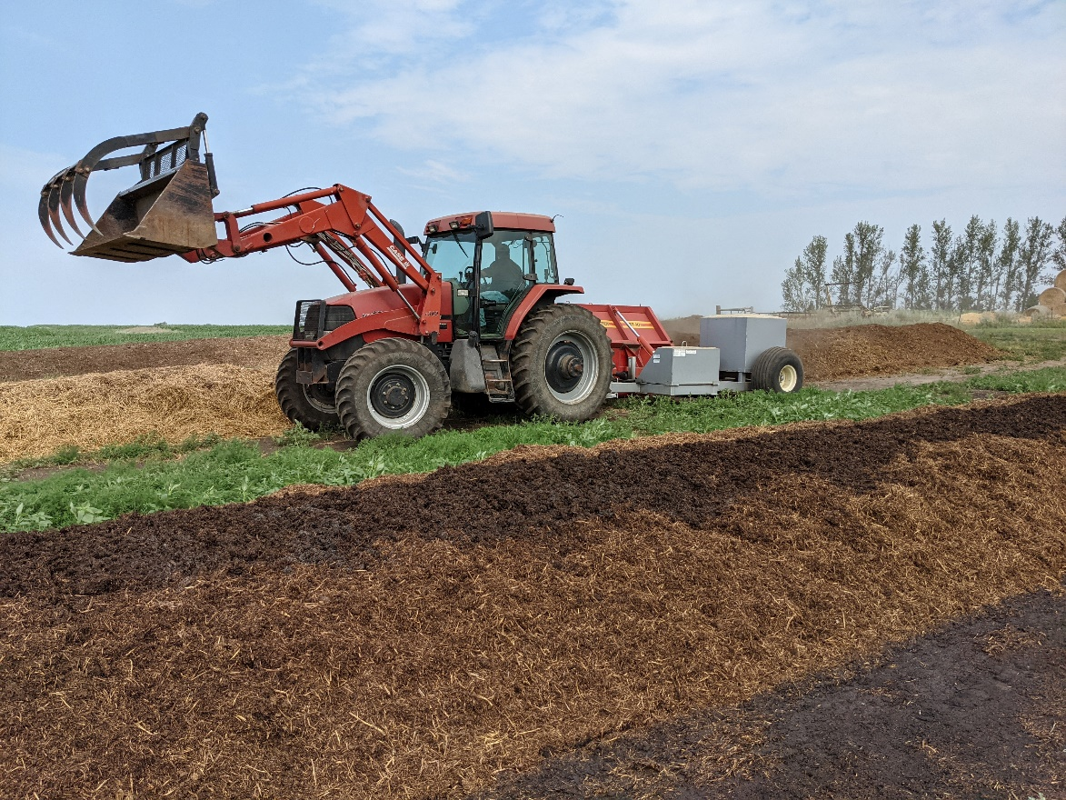
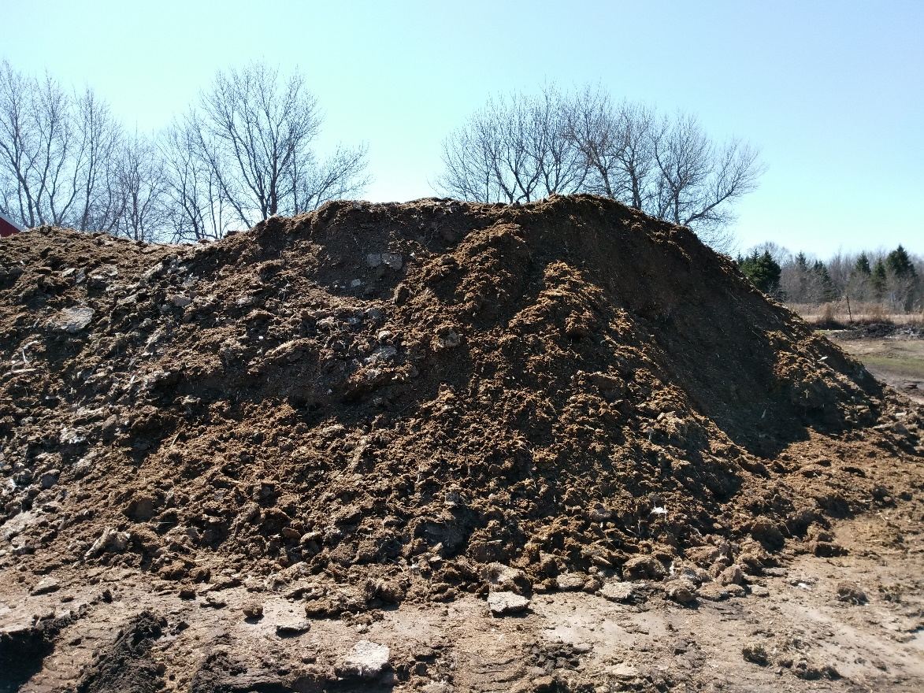
Solid manure sample trends 2012-2021 compared to MWPS/ASABE manure book values.
(+) = trending higher
(o) = no change/conflicting samples
(-) = trending lower
Solid | Total N | NH₄-N | P₂O₅ | K₂O
Swine | + | o | + | +
Dairy | o | o | o | +
Beef | + | - | + | +
Poultry | + | o | o | +
Notes:
Wilson solid manure photo

Slide 43
Poultry Solid K
Livestock Type | K₂O
MWPS | lbs/ton of manure
Broilers | 36
Pullets | 27
Layers | 26
Tom Turkeys | 30
Hen Turkeys | 30
ASABE
Poultry Leghorn Pullets | 27
Poultry Leghorn Hen | 31
Poultry Broiler Litter | 33
Poultry Turkey Litter | 30
3 Midwest labs
Poultry | 37
1 East lab
Poultry | 40
Notes:
3 MW labs – 9338 samples
1 E lab -1001 samples

Slide 44
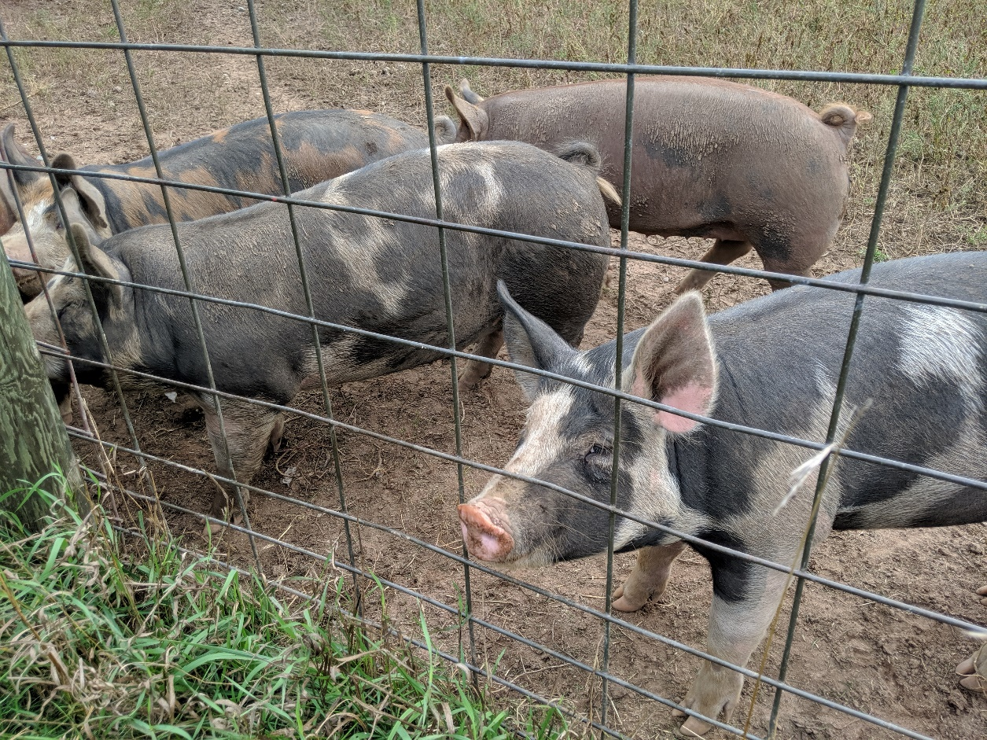
Swine Solid N
Livestock Type | Total N
MWPS | lbs/ton of manure
Swine Farrowing | 14
Swine Nursery | 13
Swine Grow-Finish | 16
Swine Breeding-Gestation | 9
Swine Feeder Pig | 10
Swine Farrow-Finish | 14
3 Midwest labs
Swine | 16
1 East lab
Swine | 18
Notes:
3 Midwest labs -356 samples
East lab – 75 samples

Slide 45
Swine Solid P
Livestock Type | P₂O₅
MWPS | lbs/ton of manure
Swine Farrowing | 6
Swine Nursery | 8
Swine Grow-Finish | 9
Swine Breeding-Gestation | 7
Swine Feeder Pig | 7
Swine Farrow-Finish | 8
3 Midwest labs
Swine | 18
1 East lab
Swine | 20
Notes:
3 Midwest labs -356 samples
East lab – 75 samples

Slide 46
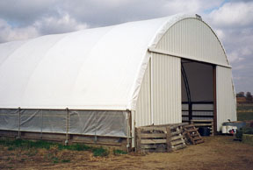
Swine Solid K
Livestock Type | K₂O
MWPS | lbs/ton of manure
Swine Farrowing | 4
Swine Nursery | 4
Swine Grow-Finish | 5
Swine Breeding-Gestation | 5
Swine Feeder Pig | 4
Swine Farrow-Finish | 5
3 Midwest labs
Swine | 7
1 East lab
Swine | 9
Notes:
3 Midwest labs -356 samples
East lab – 75 samples

Slide 47
Poultry Solid N
Livestock Type | Total N
MWPS | lbs/ton of manure
Broilers | 46
Pullets | 48
Layers | 34
Tom Turkeys | 40
Hen Turkeys | 40
ASABE
Poultry Leghorn Pullets | 43
Poultry Leghorn Hen | 37
Poultry Broiler Litter | 75
Poultry Turkey Litter | 44
3 Midwest labs
Poultry | 53
1 East lab
Poultry | 52
Notes:
3 MW labs – 9338 samples
1 E lab -1001 samples

